Slide 1
Software Testing

Slide 2
Software Testing
What is Testing?
Many people understand many definitions of testing :
Testing is the process of demonstrating that errors are not present.
The purpose of testing is to show that a program performs its intended functions correctly.
Testing is the process of establishing confidence that a program does what it is supposed to do.
These definitions are incorrect.
2

Slide 3
Software Testing
A more appropriate definition is:
“Testing is the process of executing a program with the intent of finding errors.”
3

Slide 4
Software Testing
Why should We Test ?
Although software testing is itself an expensive activity, yet launching of software without testing may lead to cost potentially much higher than that of testing, specially in systems where human safety is involved.
In the software life cycle the earlier the errors are discovered and removed, the lower is the cost of their removal.
4

Slide 5
Software Testing
Who should Do the Testing ?
Testing requires the developers to find errors from their software.
It is difficult for software developer to point out errors from own creations.
Many organisations have made a distinction between development and testing phase by making different people responsible for each phase.
5

Slide 6
Software Testing
What should We Test ?
We should test the program’s responses to every possible input. It means, we should test for all valid and invalid inputs. Suppose a program requires two 8 bit integers as inputs. Total possible combinations are 2⁸x2⁸. If only one second it required to execute one set of inputs, it may take 18 hours to test all combinations. Practically, inputs are more than two and size is also more than 8 bits. We have also not considered invalid inputs where so many combinations are possible. Hence, complete testing is just not possible, although, we may wish to do so.
6

Slide 7
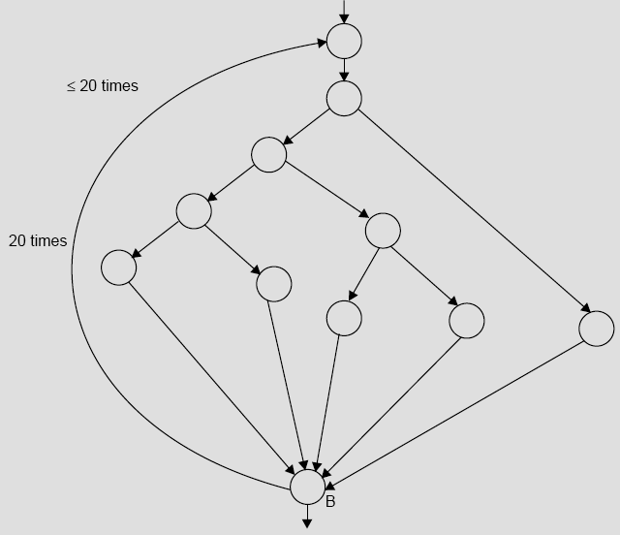
Software Testing
Fig. 1: Control flow graph
7

Slide 8
Software Testing
The number of paths in the example of Fig. 1 are 10¹⁴ or 100 trillions. It is computed from 5²⁰ + 5¹⁹ + 5¹⁸ + …… + 5¹; where 5 is the number of paths through the loop body. If only 5 minutes are required to test one test path, it may take approximately one billion years to execute every path.
8

Slide 9
Software Testing
Some Terminologies
Error, Mistake, Bug, Fault and Failure
People make errors. A good synonym is mistake. This may be a syntax error or misunderstanding of specifications. Sometimes, there are logical errors.
When developers make mistakes while coding, we call these mistakes “bugs”.
A fault is the representation of an error, where representation is the mode of expression, such as narrative text, data flow diagrams, ER diagrams, source code etc. Defect is a good synonym for fault.
A failure occurs when a fault executes. A particular fault may cause different failures, depending on how it has been exercised.
9

Slide 10
Software Testing
Test, Test Case and Test Suite
Test and Test case terms are used interchangeably. In practice, both are same and are treated as synonyms. Test case describes an input description and an expected output description.
Test Case ID
Section-I (Before Execution) | Section-II (After Execution)
Purpose : | Execution History:
Pre condition: (If any) | Result:
Inputs: | If fails, any possible reason (Optional);
Expected Outputs: | Any other observation:
Post conditions: | Any suggestion:
Written by: | Run by:
Date: | Date:
Fig. 2: Test case template
The set of test cases is called a test suite. Hence any combination of test cases may generate a test suite.
10

Slide 11
Software Testing
Verification and Validation
Verification is the process of evaluating a system or component to determine whether the products of a given development phase satisfy the conditions imposed at the start of that phase.
Validation is the process of evaluating a system or component during or at
the end of development process to determine whether it satisfies the
specified requirements .
Testing= Verification+Validation
11

Slide 12
Software Testing
Alpha, Beta and Acceptance Testing
The term Acceptance Testing is used when the software is developed for a specific customer. A series of tests are conducted to enable the customer to validate all requirements. These tests are conducted by the end user / customer and may range from adhoc tests to well planned systematic series of tests.
The terms alpha and beta testing are used when the software is developed as a product for anonymous customers.
Alpha Tests are conducted at the developer’s site by some potential customers. These tests are conducted in a controlled environment. Alpha testing may be started when formal testing process is near completion.
Beta Tests are conducted by the customers / end users at their sites. Unlike alpha testing, developer is not present here. Beta testing is conducted in a real environment that cannot be controlled by the developer.
12

Slide 13
Software Testing
Functional Testing
Input domain
Output domain
Input test data
Output test data
System under test
Fig. 3: Black box testing
13

Slide 14
Software Testing
Boundary Value Analysis
Consider a program with two input variables x and y. These input variables have specified boundaries as:
a ≤ x ≤ b
c ≤ y ≤ d
Input domain
d
y
c
a
b
x
Fig.4: Input domain for program having two input variables
14

Slide 15
Software Testing
The boundary value analysis test cases for our program with two inputs variables (x and y) that may have any value from 100 to 300 are: (200,100), (200,101), (200,200), (200,299), (200,300), (100,200), (101,200), (299,200) and
(300,200). This input domain is shown in Fig. 5. Each dot represent a test case and inner rectangle is the domain of legitimate inputs. Thus, for a program of n variables, boundary value analysis yield 4n + 1 test cases.
Input domain
400
300
y 200
100
0 100 200 300 400
x
Fig. 5: Input domain of two variables x and y with boundaries [100,300] each
15

Slide 16
Software Testing
Example- I
Consider a program for the determination of the nature of roots of a quadratic equation. Its input is a triple of positive integers (say a,b,c) and values may be from interval [0,100]. The program output may have one of the following words.
[Not a quadratic equation; Real roots; Imaginary roots; Equal roots] Design the boundary value test cases.
16

Slide 17
Software Testing
Solution
Quadratic equation will be of type:
ax²+bx+c=0 Roots are real if (b²-4ac)>0
Roots are imaginary if (b²-4ac)<0 Roots are equal if (b²-4ac)=0 Equation is not quadratic if a=0
17

Slide 18
Software Testing
The boundary value test cases are :
Test Case | a | b | c | Expected output
1 | 0 | 50 | 50 | Not Quadratic
2 | 1 | 50 | 50 | Real Roots
3 | 50 | 50 | 50 | Imaginary Roots
4 | 99 | 50 | 50 | Imaginary Roots
5 | 100 | 50 | 50 | Imaginary Roots
6 | 50 | 0 | 50 | Imaginary Roots
7 | 50 | 1 | 50 | Imaginary Roots
8 | 50 | 99 | 50 | Imaginary Roots
9 | 50 | 100 | 50 | Equal Roots
10 | 50 | 50 | 0 | Real Roots
11 | 50 | 50 | 1 | Real Roots
12 | 50 | 50 | 99 | Imaginary Roots
13 | 50 | 50 | 100 | Imaginary Roots
18

Slide 19
Software Testing
Example – 2
Consider a program for determining the Previous date. Its input is a triple of day, month and year with the values in the range
1 ≤ month ≤ 12
1 ≤ day ≤ 31
1900 ≤ year ≤ 2025
The possible outputs would be Previous date or invalid input date. Design the boundary value test cases.
19

Slide 20
Software Testing
Solution
The Previous date program takes a date as input and checks it for validity. If valid, it returns the previous date as its output.
With single fault assumption theory, 4n+1 test cases can be designed and which are equal to 13.
20

Slide 21
Software Testing
The boundary value test cases are:
Test Case | Month | Day | Year | Expected output
1 | 6 | 15 | 1900 | 14 June, 1900
2 | 6 | 15 | 1901 | 14 June, 1901
3 | 6 | 15 | 1962 | 14 June, 1962
4 | 6 | 15 | 2024 | 14 June, 2024
5 | 6 | 15 | 2025 | 14 June, 2025
6 | 6 | 1 | 1962 | 31 May, 1962
7 | 6 | 2 | 1962 | 1 June, 1962
8 | 6 | 30 | 1962 | 29 June, 1962
9 | 6 | 31 | 1962 | Invalid date
10 | 1 | 15 | 1962 | 14 January, 1962
11 | 2 | 15 | 1962 | 14 February, 1962
12 | 11 | 15 | 1962 | 14 November, 1962
13 | 12 | 15 | 1962 | 14 December, 1962
21

Slide 22
Software Testing
Example – 3
Consider a simple program to classify a triangle. Its inputs is a triple of positive integers (say x, y, z) and the date type for input parameters ensures that these will be integers greater than 0 and less than or equal to 100. The program output may be one of the following words:
[Scalene; Isosceles; Equilateral; Not a triangle] Design the boundary value test cases.
22

Slide 23
Software Testing
Solution
The boundary value test cases are shown below:
Test case | x | y | z | Expected Output
1 | 50 | 50 | 1 | Isosceles
2 | 50 | 50 | 2 | Isosceles
3 | 50 | 50 | 50 | Equilateral
4 | 50 | 50 | 99 | Isosceles
5 | 50 | 50 | 100 | Not a triangle
6 | 50 | 1 | 50 | Isosceles
7 | 50 | 2 | 50 | Isosceles
8 | 50 | 99 | 50 | Isosceles
9 | 50 | 100 | 50 | Not a triangle
10 | 1 | 50 | 50 | Isosceles
11 | 2 | 50 | 50 | Isosceles
12 | 99 | 50 | 50 | Isosceles
13 | 100 | 50 | 50 | Not a triangle
23

Slide 24
Software Testing
Robustness testing
It is nothing but the extension of boundary value analysis. Here, we would like to see, what happens when the extreme values are exceeded with a value slightly greater than the maximum, and a value slightly less than minimum. It means, we want to go outside the legitimate boundary of input domain. This extended form of boundary value analysis is called robustness testing and shown in Fig. 6
There are four additional test cases which are outside the legitimate input domain. Hence total test cases in robustness testing are 6n+1, where n is the number of input variables. So, 13 test cases are:
(200,99), (200,100), (200,101), (200,200), (200,299), (200,300)
(200,301), (99,200), (100,200), (101,200), (299,200), (300,200), (301,200)
24

Slide 25
Software Testing
400
300
200
100
y
0
100 200 300
x
400
Fig. 8.6: Robustness test cases for two variables x and y with range [100,300] each
25

Slide 26
Software Testing
Worst-case testing
If we reject “single fault” assumption theory of reliability and may like to see what happens when more than one variable has an extreme value. In electronic circuits analysis, this is called “worst case analysis”. It is more thorough in the sense that boundary value test cases are a proper subset of worst case test cases. It requires more effort. Worst case testing for a function of n variables generate 5^{n} test cases as opposed to 4n+1 test cases for boundary value analysis. Our two variables example will have 5²=25 test cases and are given in table 1.
26

Slide 27
Software Testing
Table 1: Worst cases test inputs for two variables example
Test case number | Inputs |  | Test case number | Inputs
 | x | y |  | x | y
1 | 100 | 100 | 14 | 200 | 299
2 | 100 | 101 | 15 | 200 | 300
3 | 100 | 200 | 16 | 299 | 100
4 | 100 | 299 | 17 | 299 | 101
5 | 100 | 300 | 18 | 299 | 200
6 | 101 | 100 | 19 | 299 | 299
7 | 101 | 101 | 20 | 299 | 300
8 | 101 | 200 | 21 | 300 | 100
9 | 101 | 299 | 22 | 300 | 101
10 | 101 | 300 | 23 | 300 | 200
11 | 200 | 100 | 24 | 300 | 299
12 | 200 | 101 | 25 | 300 | 300
13 | 200 | 200 | --
27

Slide 28
Software Testing
Example - 8.4
Consider the program for the determination of nature of roots of a quadratic equation as explained in example 8.1. Design the Robust test case and worst test cases for this program.
28

Slide 29
Software Testing
Solution
Robust test cases are 6n+1. Hence, in 3 variable input cases total number of test cases are 19 as given on next slide:
29

Slide 30
Software Testing
Test case | a | b | c | Expected Output
1 | -1 | 50 | 50 | Invalid input`
2 | 0 | 50 | 50 | Not quadratic equation
3 | 1 | 50 | 50 | Real roots
4 | 50 | 50 | 50 | Imaginary roots
5 | 99 | 50 | 50 | Imaginary roots
6 | 100 | 50 | 50 | Imaginary roots
7 | 101 | 50 | 50 | Invalid input
8 | 50 | -1 | 50 | Invalid input
9 | 50 | 0 | 50 | Imaginary roots
10 | 50 | 1 | 50 | Imaginary roots
11 | 50 | 99 | 50 | Imaginary roots
12 | 50 | 100 | 50 | Equal roots
13 | 50 | 101 | 50 | Invalid input
14 | 50 | 50 | -1 | Invalid input
15 | 50 | 50 | 0 | Real roots
16 | 50 | 50 | 1 | Real roots
17 | 50 | 50 | 99 | Imaginary roots
18 | 50 | 50 | 100 | Imaginary roots
19 | 50 | 50 | 101 | Invalid input
30

Slide 31
Software Testing
In case of worst test case total test cases are 5^{n}. Hence, 125 test cases will be generated in worst test cases. The worst test cases are given below:
Test Case | a | b | c | Expected output
1 | 0 | 0 | 0 | Not Quadratic
2 | 0 | 0 | 1 | Not Quadratic
3 | 0 | 0 | 50 | Not Quadratic
4 | 0 | 0 | 99 | Not Quadratic
5 | 0 | 0 | 100 | Not Quadratic
6 | 0 | 1 | 0 | Not Quadratic
7 | 0 | 1 | 1 | Not Quadratic
8 | 0 | 1 | 50 | Not Quadratic
9 | 0 | 1 | 99 | Not Quadratic
10 | 0 | 1 | 100 | Not Quadratic
11 | 0 | 50 | 0 | Not Quadratic
12 | 0 | 50 | 1 | Not Quadratic
13 | 0 | 50 | 50 | Not Quadratic
14 | 0 | 50 | 99 | Not Quadratic
31

Slide 32

Software Testing
Test Case | A | b | c | Expected output
15 | 0 | 50 | 100 | Not Quadratic
16 | 0 | 99 | 0 | Not Quadratic
17 | 0 | 99 | 1 | Not Quadratic
18 | 0 | 99 | 50 | Not Quadratic
19 | 0 | 99 | 99 | Not Quadratic
20 | 0 | 99 | 100 | Not Quadratic
21 | 0 | 100 | 0 | Not Quadratic
22 | 0 | 100 | 1 | Not Quadratic
23 | 0 | 100 | 50 | Not Quadratic
24 | 0 | 100 | 99 | Not Quadratic
25 | 0 | 100 | 100 | Not Quadratic
26 | 1 | 0 | 0 | Equal Roots
27 | 1 | 0 | 1 | Imaginary
28 | 1 | 0 | 50 | Imaginary
29 | 1 | 0 | 99 | Imaginary
30 | 1 | 0 | 100 | Imaginary
31 | 1 | 1 | 0 | Real Roots
32

Slide 33
Software Testing
Test Case | A | b | C | Expected output
32 | 1 | 1 | 1 | Imaginary
33 | 1 | 1 | 50 | Imaginary
34 | 1 | 1 | 99 | Imaginary
35 | 1 | 1 | 100 | Imaginary
36 | 1 | 50 | 0 | Real Roots
37 | 1 | 50 | 1 | Real Roots
38 | 1 | 50 | 50 | Real Roots
39 | 1 | 50 | 99 | Real Roots
40 | 1 | 50 | 100 | Real Roots
41 | 1 | 99 | 0 | Real Roots
42 | 1 | 99 | 1 | Real Roots
43 | 1 | 99 | 50 | Real Roots
44` | 1 | 99 | 99 | Real Roots
45 | 1 | 99 | 100 | Real Roots
46 | 1 | 100 | 0 | Real Roots
47 | 1 | 100 | 1 | Real Roots
48 | 1 | 100 | 50 | Real Roots
33

Slide 34
Software Testing
Test Case | A | b | C | Expected output
49 | 1 | 100 | 99 | Real Roots
50 | 1 | 100 | 100 | Real Roots
51 | 50 | 0 | 0 | Equal Roots
52 | 50 | 0 | 1 | Imaginary
53 | 50 | 0 | 50 | Imaginary
54 | 50 | 0 | 99 | Imaginary
55 | 50 | 0 | 100 | Imaginary
56 | 50 | 1 | 0 | Real Roots
57 | 50 | 1 | 1 | Imaginary
58 | 50 | 1 | 50 | Imaginary
59 | 50 | 1 | 99 | Imaginary
60 | 50 | 1 | 100 | Imaginary
61 | 50 | 50 | 0 | Real Roots
62 | 50 | 50 | 1 | Real Roots
63 | 50 | 50 | 50 | Imaginary
64 | 50 | 50 | 99 | Imaginary
65 | 50 | 50 | 100 | Imaginary
34

Slide 35
Software Testing
Test Case | A | b | C | Expected output
66 | 50 | 99 | 0 | Real Roots
67 | 50 | 99 | 1 | Real Roots
68 | 50 | 99 | 50 | Imaginary
69 | 50 | 99 | 99 | Imaginary
70 | 50 | 99 | 100 | Imaginary
71 | 50 | 100 | 0 | Real Roots
72 | 50 | 100 | 1 | Real Roots
73 | 50 | 100 | 50 | Equal Roots
74 | 50 | 100 | 99 | Imaginary
75 | 50 | 100 | 100 | Imaginary
76 | 99 | 0 | 0 | Equal Roots
77 | 99 | 0 | 1 | Imaginary
78 | 99 | 0 | 50 | Imaginary
79 | 99 | 0 | 99 | Imaginary
80 | 99 | 0 | 100 | Imaginary
81 | 99 | 1 | 0 | Real Roots
82 | 99 | 1 | 1 | Imaginary
35

Slide 36
Software Testing
Test Case | A | b | C | Expected output
83 | 99 | 1 | 50 | Imaginary
84 | 99 | 1 | 99 | Imaginary
85 | 99 | 1 | 100 | Imaginary
86 | 99 | 50 | 0 | Real Roots
87 | 99 | 50 | 1 | Real Roots
88 | 99 | 50 | 50 | Imaginary
89 | 99 | 50 | 99 | Imaginary
90 | 99 | 50 | 100 | Imaginary
91 | 99 | 99 | 0 | Real Roots
92 | 99 | 99 | 1 | Real Roots
93 | 99 | 99 | 50 | Imaginary Roots
94 | 99 | 99 | 99 | Imaginary
95 | 99 | 99 | 100 | Imaginary
96 | 99 | 100 | 0 | Real Roots
97 | 99 | 100 | 1 | Real Roots
98 | 99 | 100 | 50 | Imaginary
99 | 99 | 100 | 99 | Imaginary
100 | 99 | 100 | 100 | Imaginary
36

Slide 37
Software Testing
Test Case | A | b | C | Expected output
101 | 100 | 0 | 0 | Equal Roots
102 | 100 | 0 | 1 | Imaginary
103 | 100 | 0 | 50 | Imaginary
104 | 100 | 0 | 99 | Imaginary
105 | 100 | 0 | 100 | Imaginary
106 | 100 | 1 | 0 | Real Roots
107 | 100 | 1 | 1 | Imaginary
108 | 100 | 1 | 50 | Imaginary
109 | 100 | 1 | 99 | Imaginary
110 | 100 | 1 | 100 | Imaginary
111 | 100 | 50 | 0 | Real Roots
112 | 100 | 50 | 1 | Real Roots
113 | 100 | 50 | 50 | Imaginary
114 | 100 | 50 | 99 | Imaginary
115 | 100 | 50 | 100 | Imaginary
116 | 100 | 99 | 0 | Real Roots
117 | 100 | 99 | 1 | Real Roots
118 | 100 | 99 | 50 | Imaginary
37

Slide 38
Software Testing
Test Case | A | b | C | Expected output
119 | 100 | 99 | 99 | Imaginary
120 | 100 | 99 | 100 | Imaginary
121 | 100 | 100 | 0 | Real Roots
122 | 100 | 100 | 1 | Real Roots
123 | 100 | 100 | 50 | Imaginary
124 | 100 | 100 | 99 | Imaginary
125 | 100 | 100 | 100 | Imaginary
38

Slide 39
Software Testing
Example – 5
Consider the program for the determination of previous date in a calendar as explained in example 8.2. Design the robust and worst test cases for this program.
39

Slide 40
Software Testing
Solution
Robust test cases are 6n+1. Hence total 19 robust test cases are designed and are given on next slide.
40

Slide 41
Software Testing
Test case | Month | Day | Year | Expected Output
1 | 6 | 15 | 1899 | Invalid date (outside range)
2 | 6 | 15 | 1900 | 14 June, 1900
3 | 6 | 15 | 1901 | 14 June, 1901
4 | 6 | 15 | 1962 | 14 June, 1962
5 | 6 | 15 | 2024 | 14 June, 2024
6 | 6 | 15 | 2025 | 14 June, 2025
7 | 6 | 15 | 2026 | Invalid date (outside range)
8 | 6 | 0 | 1962 | Invalid date
9 | 6 | 1 | 1962 | 31 May, 1962
10 | 6 | 2 | 1962 | 1 June, 1962
11 | 6 | 30 | 1962 | 29 June, 1962
12 | 6 | 31 | 1962 | Invalid date
13 | 6 | 32 | 1962 | Invalid date
14 | 0 | 15 | 1962 | Invalid date
15 | 1 | 15 | 1962 | 14 January, 1962
16 | 2 | 15 | 1962 | 14 February, 1962
17 | 11 | 15 | 1962 | 14 November, 1962
18 | 12 | 15 | 1962 | 14 December, 1962
19 | 13 | 15 | 1962 | Invalid date
41

Slide 42
Software Testing
In case of worst test case total test cases are 5^{n}. Hence, 125 test cases will be generated in worst test cases. The worst test cases are given below:
Test Case | Month | Day | Year | Expected output
1 | 1 | 1 | 1900 | 31 December, 1899
2 | 1 | 1 | 1901 | 31 December, 1900
3 | 1 | 1 | 1962 | 31 December, 1961
4 | 1 | 1 | 2024 | 31 December, 2023
5 | 1 | 1 | 2025 | 31 December, 2024
6 | 1 | 2 | 1900 | 1 January, 1900
7 | 1 | 2 | 1901 | 1 January, 1901
8 | 1 | 2 | 1962 | 1 January, 1962
9 | 1 | 2 | 2024 | 1 January, 2024
10 | 1 | 2 | 2025 | 1 January, 2025
11 | 1 | 15 | 1900 | 14 January, 1900
12 | 1 | 15 | 1901 | 14 January, 1901
13 | 1 | 15 | 1962 | 14 January, 1962
14 | 1 | 15 | 2024 | 14 January, 2024
42

Slide 43
Software Testing
Test Case | A | b | c | Expected output
15 | 1 | 15 | 2025 | 14 January, 2025
16 | 1 | 30 | 1900 | 29 January, 1900
17 | 1 | 30 | 1901 | 29 January, 1901
18 | 1 | 30 | 1962 | 29 January, 1962
19 | 1 | 30 | 2024 | 29 January, 2024
20 | 1 | 30 | 2025 | 29 January, 2025
21 | 1 | 31 | 1900 | 30 January, 1900
22 | 1 | 31 | 1901 | 30 January, 1901
23 | 1 | 31 | 1962 | 30 January, 1962
24 | 1 | 31 | 2024 | 30 January, 2024
25 | 1 | 31 | 2025 | 30 January, 2025
26 | 2 | 1 | 1900 | 31 January, 1900
27 | 2 | 1 | 1901 | 31 January, 1901
28 | 2 | 1 | 1962 | 31 January, 1962
29 | 2 | 1 | 2024 | 31 January, 2024
30 | 2 | 1 | 2025 | 31 January, 2025
31 | 2 | 2 | 1900 | 1 February, 1900
43

Slide 44
Software Testing
Test Case | Month | Day | Year | Expected output
32 | 2 | 2 | 1901 | 1 February, 1901
33 | 2 | 2 | 1962 | 1 February, 1962
34 | 2 | 2 | 2024 | 1 February, 2024
35 | 2 | 2 | 2025 | 1 February, 2025
36 | 2 | 15 | 1900 | 14 February, 1900
37 | 2 | 15 | 1901 | 14 February, 1901
38 | 2 | 15 | 1962 | 14 February, 1962
39 | 2 | 15 | 2024 | 14 February, 2024
40 | 2 | 15 | 2025 | 14 February, 2025
41 | 2 | 30 | 1900 | Invalid date
42 | 2 | 30 | 1901 | Invalid date
43 | 2 | 30 | 1962 | Invalid date
44 | 2 | 30 | 2024 |  | Invalid date
45 | 2 | 30 | 2025 |  | Invalid date
46 | 2 | 31 | 1900 |  | Invalid date
47 | 2 | 31 | 1901 |  | Invalid date
48 | 2 | 31 | 1962 |  | Invalid date
44

Slide 45
Software Testing
Test Case | Month | Day | Year | Expected output
49 | 2 | 31 | 2024 | Invalid date
50 | 2 | 31 | 2025 | Invalid date
51 | 6 | 1 | 1900 | 31 May, 1900
52 | 6 | 1 | 1901 | 31 May, 1901
53 | 6 | 1 | 1962 | 31 May, 1962
54 | 6 | 1 | 2024 | 31 May, 2024
55 | 6 | 1 | 2025 | 31 May, 2025
56 | 6 | 2 | 1900 | 1 June, 1900
57 | 6 | 2 | 1901 | 1 June, 1901
58 | 6 | 2 | 1962 | 1 June, 1962
59 | 6 | 2 | 2024 | 1 June, 2024
60 | 6 | 2 | 2025 | 1 June, 2025
61 | 6 | 15 | 1900 | 14 June, 1900
62 | 6 | 15 | 1901 | 14 June, 1901
63 | 6 | 15 | 1962 | 14 June, 1962
64 | 6 | 15 | 2024 | 14 June, 2024
65 | 6 | 15 | 2025 | 14 June, 2025
45

Slide 46
Software Testing
Test Case | Month | Day | Year | Expected output
66 | 6 | 30 | 1900 | 29 June, 1900
67 | 6 | 30 | 1901 | 29 June, 1901
68 | 6 | 30 | 1962 | 29 June, 1962
69 | 6 | 30 | 2024 | 29 June, 2024
70 | 6 | 30 | 2025 | 29 June, 2025
71 | 6 | 31 | 1900 | Invalid date
72 | 6 | 31 | 1901 | Invalid date
73 | 6 | 31 | 1962 | Invalid date
74 | 6 | 31 | 2024 | Invalid date
75 | 6 | 31 | 2025 | Invalid date
76 | 11 | 1 | 1900 | 31 October, 1900
77 | 11 | 1 | 1901 | 31 October, 1901
78 | 11 | 1 | 1962 | 31 October, 1962
79 | 11 | 1 | 2024 | 31 October, 2024
80 | 11 | 1 | 2025 | 31 October, 2025
81 | 11 | 2 | 1900 | 1 November, 1900
82 | 11 | 2 | 1901 | 1 November, 1901
46

Slide 47
Software Testing
Test Case | Month | Day | Year | Expected output
83 | 11 | 2 | 1962 | 1 November, 1962
84 | 11 | 2 | 2024 | 1 November, 2024
85 | 11 | 2 | 2025 | 1 November, 2025
86 | 11 | 15 | 1900 | 14 November, 1900
87 | 11 | 15 | 1901 | 14 November, 1901
88 | 11 | 15 | 1962 | 14 November, 1962
89 | 11 | 15 | 2024 | 14 November, 2024
90 | 11 | 15 | 2025 | 14 November, 2025
91 | 11 | 30 | 1900 | 29 November, 1900
92 | 11 | 30 | 1901 | 29 November, 1901
93 | 11 | 30 | 1962 | 29 November, 1962
94 | 11 | 30 | 2024 | 29 November, 2024
95 | 11 | 30 | 2025 | 29 November, 2025
96 | 11 | 31 | 1900 | Invalid date
97 | 11 | 31 | 1901 | Invalid date
98 | 11 | 31 | 1962 | Invalid date
99 | 11 | 31 | 2024 | Invalid date
100 | 11 | 31 | 2025 | Invalid date
47

Slide 48
Software Testing
Test Case | Month | Day | Year | Expected output
101 | 12 | 1 | 1900 | 30 November, 1900
102 | 12 | 1 | 1901 | 30 November, 1901
103 | 12 | 1 | 1962 | 30 November, 1962
104 | 12 | 1 | 2024 | 30 November, 2024
105 | 12 | 1 | 2025 | 30 November, 2025
106 | 12 | 2 | 1900 | 1 December, 1900
107 | 12 | 2 | 1901 | 1 December, 1901
108 | 12 | 2 | 1962 | 1 December, 1962
109 | 12 | 2 | 2024 | 1 December, 2024
110 | 12 | 2 | 2025 | 1 December, 2025
111 | 12 | 15 | 1900 | 14 December, 1900
112 | 12 | 15 | 1901 | 14 December, 1901
113 | 12 | 15 | 1962 | 14 December, 1962
114 | 12 | 15 | 2024 | 14 December, 2024
115 | 12 | 15 | 2025 | 14 December, 2025
116 | 12 | 30 | 1900 | 29 December, 1900
117 | 12 | 30 | 1901 | 29 December, 1901
118 | 12 | 30 | 1962 | 29 December, 1962
48

Slide 49
Software Testing
Test Case | Month | Day | Year | Expected output
119 | 12 | 30 | 2024 | 29 December, 2024
120 | 12 | 30 | 2025 | 29 December, 2025
121 | 12 | 31 | 1900 | 30 December, 1900
122 | 12 | 31 | 1901 | 30 December, 1901
123 | 12 | 31 | 1962 | 30 December, 1962
124 | 12 | 31 | 2024 | 30 December, 2024
125 | 12 | 31 | 2025 | 30 December, 2025
49

Slide 50
Software Testing
Example – 6
Consider the triangle problem. Generate robust and worst test cases for this problem.
50

Slide 51
Software Testing
Solution
Robust test cases are given on next slide.
51

Slide 52
Software Testing
` | x | y | z | Expected Output
1 | 50 | 50 | 0 | Invalid input`
2 | 50 | 50 | 1 | Isosceles
3 | 50 | 50 | 2 | Isosceles
4 | 50 | 50 | 50 | Equilateral
5 | 50 | 50 | 99 | Isosceles
6 | 50 | 50 | 100 | Not a triangle
7 | 50 | 50 | 101 | Invalid input
8 | 50 | 0 | 50 | Invalid input
9 | 50 | 1 | 50 | Isosceles
10 | 50 | 2 | 50 | Isosceles
11 | 50 | 99 | 50 | Isosceles
12 | 50 | 100 | 50 | Not a triangle
13 | 50 | 101 | 50 | Invalid input
14 | 0 | 50 | 50 | Invalid input
15 | 1 | 50 | 50 | Isosceles
16 | 2 | 50 | 50 | Isosceles
17 | 99 | 50 | 50 | Isosceles
18 | 100 | 50 | 50 | Not a triangle
19 | 100 | 50 | 50 | Invalid input
52

Slide 53
Software Testing
Worst test cases are 125 and are given below:
Test Case | x | y | z | Expected output
1 | 1 | 1 | 1 | Equilateral
2 | 1 | 1 | 2 | Not a triangle
3 | 1 | 1 | 50 | Not a triangle
4 | 1 | 1 | 99 | Not a triangle
5 | 1 | 1 | 100 | Not a triangle
6 | 1 | 2 | 1 | Not a triangle
7 | 1 | 2 | 2 | Isosceles
8 | 1 | 2 | 50 | Not a triangle
9 | 1 | 2 | 99 | Not a triangle
10 | 1 | 2 | 100 | Not a triangle
11 | 1 | 50 | 1 | Not a triangle
12 | 1 | 50 | 2 | Not a triangle
13 | 1 | 50 | 50 | Isosceles
14 | 1 | 50 | 99 | Not a triangle
53

Slide 54
Test Case | A | b | c | Expected output
15 | 1 | 50 | 100 | Not a triangle
16 | 1 | 99 | 1 | Not a triangle
17 | 1 | 99 | 2 | Not a triangle
18 | 1 | 99 | 50 | Not a triangle
19 | 1 | 99 | 99 | Isosceles
20 | 1 | 99 | 100 | Not a triangle
21 | 1 | 100 | 1 | Not a triangle
22 | 1 | 100 | 2 | Not a triangle
23 | 1 | 100 | 50 | Not a triangle
24 | 1 | 100 | 99 | Not a triangle
25 | 1 | 100 | 100 | Isosceles
26 | 2 | 1 | 1 | Not a triangle
27 | 2 | 1 | 2 | Isosceles
28 | 2 | 1 | 50 | Not a triangle
29 | 2 | 1 | 99 | Not a triangle
30 | 2 | 1 | 100 | Not a triangle
31 | 2 | 2 | 1 | Isosceles
54

Slide 55
Test Case | A | b | C | Expected output
32 | 2 | 2 | 2 | Equilateral
33 | 2 | 2 | 50 | Not a triangle
34 | 2 | 2 | 99 | Not a triangle
35 | 2 | 2 | 100 | Not a triangle
36 | 2 | 50 | 1 | Not a triangle
37 | 2 | 50 | 2 | Not a triangle
38 | 2 | 50 | 50 | Isosceles
39 | 2 | 50 | 99 | Not a triangle
40 | 2 | 50 | 100 | Not a triangle
41 | 2 | 99 | 1 | Not a triangle
42 | 2 | 99 | 2 | Not a triangle
43 | 2 | 99 | 50 | Not a triangle
44 | 2 | 99 | 99 | Isosceles
45 | 2 | 99 | 100 | Scalene
46 | 2 | 100 | 1 | Not a triangle
47 | 2 | 100 | 2 | Not a triangle
48 | 2 | 100 | 50 | Not a triangle
55

Slide 56
Test Case | A | b | C | Expected output
49 | 2 | 100 | 50 | Scalene
50 | 2 | 100 | 99 | Isosceles
51 | 50 | 1 | 100 | Not a triangle
52 | 50 | 1 | 1 | Not a triangle
53 | 50 | 1 | 2 | Isosceles
54 | 50 | 1 | 50 | Not a triangle
55 | 50 | 1 | 99 | Not a triangle
56 | 50 | 2 | 100 | Not a triangle
57 | 50 | 2 | 1 | Not a triangle
58 | 50 | 2 | 2 | Isosceles
59 | 50 | 2 | 50 | Not a triangle
60 | 50 | 2 | 99 | Not a triangle
61 | 50 | 50 | 100 | Isosceles
62 | 50 | 50 | 1 | Isosceles
63 | 50 | 50 | 2 | Equilateral
64 | 50 | 50 | 50 | Isosceles
65 | 50 | 50 | 99 | Not a triangle
56

Slide 57
Test Case | A | B | C | Expected output
66 | 50 | 99 | 1 | Not a triangle
67 | 50 | 99 | 2 | Not a triangle
68 | 50 | 99 | 50 | Isosceles
69 | 50 | 99 | 99 | Isosceles
70 | 50 | 99 | 100 | Scalene
71 | 50 | 100 | 1 | Not a triangle
72 | 50 | 100 | 2 | Not a triangle
73 | 50 | 100 | 50 | Not a triangle
74 | 50 | 100 | 99 | Scalene
75 | 50 | 100 | 100 | Isosceles
76 | 50 | 1 | 1 | Not a triangle
77 | 99 | 1 | 2 | Not a triangle
78 | 99 | 1 | 50 | Not a triangle
79 | 99 | 1 | 99 | Isosceles
80 | 99 | 1 | 100 | Not a triangle
81 | 99 | 2 | 1 | Not a triangle
82 | 99 | 2 | 2 | Not a triangle
57

Slide 58
Test Case | A | b | C | Expected output
83 | 99 | 2 | 50 | Not a triangle
84 | 99 | 2 | 99 | Isosceles
85 | 99 | 2 | 100 | Scalene
86 | 99 | 50 | 1 | Not a triangle
87 | 99 | 50 | 2 | Not a triangle
88 | 99 | 50 | 50 | Isosceles
89 | 99 | 50 | 99 | Isosceles
90 | 99 | 50 | 100 | Scalene
91 | 99 | 99 | 1 | Isosceles
92 | 99 | 99 | 2 | Isosceles
93 | 99 | 99 | 50 | Isosceles
94 | 99 | 99 | 99 | Equilateral
95 | 99 | 99 | 100 | Isosceles
96 | 99 | 100 | 1 | Not a triangle
97 | 99 | 100 | 2 | Scalene
98 | 99 | 100 | 50 | Scalene
99 | 99 | 100 | 99 | Isosceles
100 | 99 | 100 | 100 | Isosceles
58

Slide 59
Test Case | A | b | C | Expected output
101 | 100 | 1 | 1 | Not a triangle
102 | 100 | 1 | 2 | Not a triangle
103 | 100 | 1 | 50 | Not a triangle
104 | 100 | 1 | 99 | Not a triangle
105 | 100 | 1 | 100 | Isosceles
106 | 100 | 2 | 1 | Not a triangle
107 | 100 | 2 | 2 | Not a triangle
108 | 100 | 2 | 50 | Not a triangle
109 | 100 | 2 | 99 | Scalene
110 | 100 | 2 | 100 | Isosceles
111 | 100 | 50 | 1 | Not a triangle
112 | 100 | 50 | 2 | Not a triangle
113 | 100 | 50 | 50 | Not a triangle
114 | 100 | 50 | 99 | Scalene
115 | 100 | 50 | 100 | Isosceles
116 | 100 | 99 | 1 | Not a triangle
117 | 100 | 99 | 2 | Scalene
118 | 100 | 99 | 50 | Scalene
59

Slide 60
Test Case | A | b | C | Expected output
119 | 100 | 99 | 99 | Isosceles
120 | 100 | 99 | 100 | Isosceles
121 | 100 | 100 | 1 | Isosceles
122 | 100 | 100 | 2 | Isosceles
123 | 100 | 100 | 50 | Isosceles
124 | 100 | 100 | 99 | Isosceles
125 | 100 | 100 | 100 | Equilateral
60

Slide 61
Software Testing
Equivalence Class Testing
In this method, input domain of a program is partitioned into a finite number of
equivalence classes such
that one can reasonably assume, absolutely sure, that the test of a representative value of
but not be
class is
equivalent to a test of any other value.
Two steps are required to implementing this method:
each
The equivalence classes are identified by taking each input condition and partitioning it into valid and invalid classes. For example, if an input condition specifies a range of values from 1 to 999, we identify one valid equivalence class [1<item<999]; and two invalid equivalence classes [item<1] and [item>999].
Generate the test cases using the equivalence classes identified in the previous step. This is performed by writing test cases covering all the valid equivalence classes. Then a test case is written for each invalid equivalence class so that no test contains more than one invalid class. This is to ensure that no two invalid classes mask each other.
61

Slide 62
Software Testing
Invalid input
Valid inputs
System under test
Outputs
Input domain Output domain
Fig. 7: Equivalence partitioning
Most of the time, equivalence class testing defines classes of the input domain. However, equivalence classes should also be defined for output domain. Hence, we should design equivalence classes based on input and output domain.
62

Slide 63
Software Testing
Example 7
Consider the program for the determination of nature of roots of a quadratic equation. Identify the equivalence class test cases for output and input domains.
63

Slide 64
Software Testing
Solution
Output domain equivalence class test cases can be identified as follows: O₁={<a,b,c>:Not a quadratic equation if a = 0}
O₁={<a,b,c>:Real roots if (b²-4ac)>0}
O₁={<a,b,c>:Imaginary roots if (b²-4ac)<0} O₁={<a,b,c>:Equal roots if (b²-4ac)=0}`
The number of test cases can be derived form above relations and shown below:
Test case | a | b | c | Expected output
1 | 0 | 50 | 50 | Not a quadratic equation
2 | 1 | 50 | 50 | Real roots
3 | 50 | 50 | 50 | Imaginary roots
4 | 50 | 100 | 50 | Equal roots
64

Slide 65
Software Testing
We may have another set of test cases based on input domain.
I₁= {a: a = 0} I₂= {a: a < 0}
I₃= {a: 1 ≤ a ≤ 100} I₄= {a: a > 100}
I₅= {b: 0 ≤ b ≤ 100}
I₆= {b: b < 0}
I₇= {b: b > 100}
I₈= {c: 0 ≤ c ≤ 100} I₉= {c: c < 0}
I₁₀={c: c > 100}
65

Slide 66
Software Testing
Test Case | a | b | c | Expected output
1 | 0 | 50 | 50 | Not a quadratic equation
2 | -1 | 50 | 50 | Invalid input
3 | 50 | 50 | 50 | Imaginary Roots
4 | 101 | 50 | 50 | invalid input
5 | 50 | 50 | 50 | Imaginary Roots
6 | 50 | -1 | 50 | invalid input
7 | 50 | 101 | 50 | invalid input
8 | 50 | 50 | 50 | Imaginary Roots
9 | 50 | 50 | -1 | invalid input
10 | 50 | 50 | 101 | invalid input
Here test cases 5 and 8 are redundant test cases. If we choose any value other than nominal, we may not have redundant test cases. Hence total test cases are 10+4=14 for this problem.
66

Slide 67
Software Testing
Example 8
Consider the program for determining the previous date in a calendar as explained in example 3. Identify the equivalence class test cases for output & input domains.
67

Slide 68
Software Testing
Solution
Output domain equivalence class are: O₁={<D,M,Y>: Previous date if all are valid inputs}
O₁={<D,M,Y>: Invalid date if any input makes the date invalid}
Test case | M | D | Y | Expected output
1 | 6 | 15 | 1962 | 14 June, 1962
2 | 6 | 31 | 1962 | Invalid date
68

Slide 69
Software Testing
We may have another set of test cases which are based on input domain.
I₁={month: 1 ≤ m ≤ 12} I₂={month: m < 1} I₃={month: m > 12} I₄={day: 1 ≤ D ≤ 31}
I₅={day: D < 1} I₆={day: D > 31}
I₇={year: 1900 ≤ Y ≤ 2025} I₈={year: Y < 1900}
I₉={year: Y > 2025}
69

Slide 70
Software Testing
Inputs domain test cases are :
Test Case | M | D | Y | Expected output
1 | 6 | 15 | 1962 | 14 June, 1962
2 | -1 | 15 | 1962 | Invalid input
3 | 13 | 15 | 1962 | invalid input
4 | 6 | 15 | 1962 | 14 June, 1962
5 | 6 | -1 | 1962 | invalid input
6 | 6 | 32 | 1962 | invalid input
7 | 6 | 15 | 1962 | 14 June, 1962
8 | 6 | 15 | 1899 | invalid input (Value out of range)
9 | 6 | 15 | 2026 | invalid input (Value out of range)
70

Slide 71
Software Testing
Example – 9
Consider the triangle problem specified in a example. Identify the equivalence class test cases for output and input domain.
71

Slide 72
Software Testing
Solution
Output domain equivalence classes are:
O₁={<x,y,z>: Equilateral triangle with sides x,y,z} O₁={<x,y,z>: Isosceles triangle with sides x,y,z} O₁={<x,y,z>: Scalene triangle with sides x,y,z} O₁={<x,y,z>: Not a triangle with sides x,y,z}
The test cases are:
Test case | x | y | z | Expected Output
1 | 50 | 50 | 50 | Equilateral
2 | 50 | 50 | 99 | Isosceles
3 | 100 | 99 | 50 | Scalene
4 | 50 | 100 | 50 | Not a triangle
72

Slide 73
Software Testing
Input domain based classes are:
I₁={x: x < 1} I₂={x: x > 100}
I₃={x: 1 ≤ x ≤ 100} I₄={y: y < 1}
I₅={y: y > 100}
I₆={y: 1 ≤ y ≤ 100} I₇={z: z < 1}
I₈={z: z > 100} I₉={z: 1 ≤ z ≤ 100}
73

Slide 74
Software Testing
Some inputs domain test cases can be obtained using the relationship amongst x,y and z.
I₁₀={< x,y,z >: x = y = z} I₁₁={< x,y,z >: x = y, x ≠ z} I₁₂={< x,y,z >: x = z, x ≠ y} I₁₃={< x,y,z >: y = z, x ≠ y}
I₁₄={< x,y,z >: x ≠ y, x ≠ z, y ≠ z} I₁₅={< x,y,z >: x = y + z}
I₁₆={< x,y,z >: x > y +z} I₁₇={< x,y,z >: y = x +z}
I₁₈={< x,y,z >: y > x + z} I₁₉={< x,y,z >: z = x + y} I₂₀={< x,y,z >: z > x +y}
74

Slide 75
Software Testing
Test cases derived from input domain are:
Test case | x | y | z | Expected Output
1 | 0 | 50 | 50 | Invalid input
2 | 101 | 50 | 50 | Invalid input
3 | 50 | 50 | 50 | Equilateral
4 | 50 | 0 | 50 | Invalid input
5 | 50 | 101 | 50 | Invalid input
6 | 50 | 50 | 50 | Equilateral
7 | 50 | 50 | 0 | Invalid input
8 | 50 | 50 | 101 | Invalid input
9 | 50 | 50 | 50 | Equilateral
10 | 60 | 60 | 60 | Equilateral
11 | 50 | 50 | 60 | Isosceles
12 | 50 | 60 | 50 | Isosceles
13 | 60 | 50 | 50 | Isosceles
75

Slide 76
Software Testing
Test case | x | y | z | Expected Output
14 | 100 | 99 | 50 | Scalene
15 | 100 | 50 | 50 | Not a triangle
16 | 100 | 50 | 25 | Not a triangle
17 | 50 | 100 | 50 | Not a triangle
18 | 50 | 100 | 25 | Not a triangle
19 | 50 | 50 | 100 | Not a triangle
20 | 25 | 50 | 100 | Not a triangle
76

Slide 77
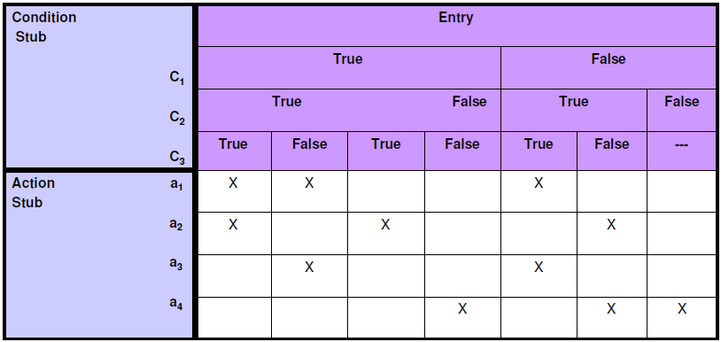
Software Testing
Decision Table Based Testing
Table 2: Decision table terminology
77

Slide 78
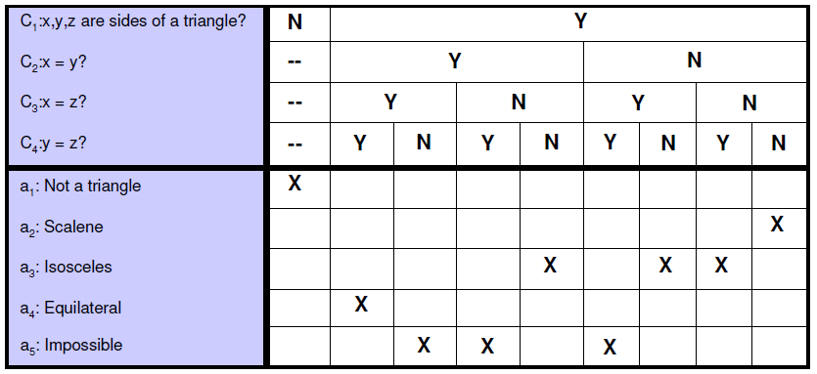
Software Testing
Test case design
Table 3: Decision table for triangle problem
78

Slide 79
Software Testing
Conditions C₁ : x < y + z ? | F | T | T | T | T | T | T | T | T | T | T
C₂ : y < x + z ? | -- | F | T | T | T | T | T | T | T | T | T
C₃ : z < x + y ? | -- | -- | F | T | T | T | T | T | T | T | T
C₄ : x = y ? | -- | -- | -- | T | T | T | T | F | F | F | F
C₅ : x = z ? | -- | -- | -- | T | T | F | F | T | T | F | F
C₆ : y = z ? | -- | -- | -- | T | F | T | F | T | F | T | F
a₁ : Not a triangle | X | X | X
a₂ : Scalene |  |  |  |  |  |  |  |  |  |  | X
a₃ : Isosceles |  |  |  |  |  |  | X |  | X | X
a₄ : Equilateral |  |  |  | X
a₅ : Impossible |  |  |  |  | X | X |  | X
Table 4: Modified decision table
79

Slide 80
Software Testing
Example 10
Consider the triangle program specified in example 3. Identify the test cases using the decision table of Table 4.
80

Slide 81
Software Testing
Solution
There are eleven functional test cases, three to fail triangle property, three impossible cases, one each to get equilateral, scalene triangle cases, and three to get on isosceles triangle. The test cases are given in Table 5.
Test case | x | y | z | Expected Output
1 | 4 | 1 | 2 | Not a triangle
2 | 1 | 4 | 2 | Not a triangle
3 | 1 | 2 | 4 | Not a triangle
4 | 5 | 5 | 5 | Equilateral
5 | ? | ? | ? | Impossible
6 | ? | ? | ? | Impossible
7 | 2 | 2 | 3 | Isosceles
8 | ? | ? | ? | Impossible
9 | 2 | 3 | 2 | Isosceles
10 | 3 | 2 | 2 | Isosceles
11 | 3 | 4 | 5 | Scalene
Test cases of triangle problem using decision table
81

Slide 82
Software Testing
Example 11
Consider a program for the determination of Previous date. Its input is a triple of day, month and year with the values in the range
1 ≤ month ≤ 12
1 ≤ day ≤ 31
1900 ≤ year ≤ 2025
The possible outputs are “Previous date” and “Invalid date”. Design the test cases using decision table based testing.
82

Slide 83
Software Testing
Solution
The input domain can be divided into following classes: I₁= {M₁: month has 30 days}
I₂= {M₂: month has 31 days except March, August and January} I₃= {M₃: month is March}
I₄= {M₄: month is August}
I₅= {M₅: month is January} I₆= {M₆: month is February} I₇= {D₁: day = 1}
I₈= {D₂: 2 ≤ day ≤ 28}
I₉= {D₃: day = 29} I₁₀={D₄: day = 30}
I₁₁={D₅: day = 31}
I₁₂={Y₁: year is a leap year} I₁₃={Y₂: year is a common year}
83

Slide 84
Software Testing
The decision table is given below:
Sr.No. | 1 | 2 | 3 | 4 | 5 | 6 | 7 | 8 | 9 | 10 | 11 | 12 | 13 | 14 | 15
C₁: Months in | M₁ | M₁ | M₁ | M₁ | M₁ | M₁ | M₁ | M₁ | M₁ | M₁ | M₂ | M₂ | M₂ | M₂ | M₂
C₂: days in | D₁ | D₁ | D₂ | D₂ | D₃ | D₃ | D₄ | D₄ | D₅ | D₅ | D₁ | D₁ | D₂ | D₂ | D₃
C₃: year in | Y₁ | Y₂ | Y₁ | Y₂ | Y₁ | Y₂ | Y₁ | Y₂ | Y₁ | Y₂ | Y₁ | Y₂ | Y₁ | Y₂ | Y₁
a₁: Impossible |  |  |  |  |  |  |  |  | X | X
a₂: Decrement day |  |  | X | X | X | X | X | X |  |  |  |  | X | X | X
a₃: Reset day to 31 | X | X
a₄: Reset day to 30 |  |  |  |  |  |  |  |  |  |  | X | X
a₅: Reset day to 29
a₆: Reset day to 28
a₇: decrement month | X | X |  |  |  |  |  |  |  |  | X | X
a₈: Reset month to December
a₉: Decrement year
84

Slide 85
Software Testing
Sr.No. | 16 | 17 | 18 | 19 | 20 | 21 | 22 | 23 | 24 | 25 | 26 | 27 | 28 | 29 | 30
C₁: Months in | M₂ | M₂ | M₂ | M₂ | M₂ | M₃ | M₃ | M₃ | M₃ | M₃ | M₃ | M₃ | M₃ | M₃ | M₃
C₂: days in | D₃ | D₄ | D₄ | D₅ | D₅ | D₁ | D₁ | D₂ | D₂ | D₃ | D₃ | D₄ | D₄ | D₅ | D₅
C₃: year in | Y₂ | Y₁ | Y₂ | Y₁ | Y₂ | Y₁ | Y₂ | Y₁ | Y₂ | Y₁ | Y₂ | Y₁ | Y₂ | Y₁ | Y₂
a₁: Impossible
a₂: Decrement day | X | X | X | X | X |  |  | X | X | X | X | X | X | X | X
a₃: Reset day to 31
a₄: Reset day to 30
a₅: Reset day to 29 |  |  |  |  |  | X
a₆: Reset day to 28 |  |  |  |  |  |  | X
a₇: decrement month |  |  |  |  |  | X | X
a₈: Reset month to December
a₉: Decrement year
85

Slide 86
Software Testing
Sr.No. | 31 | 32 | 33 | 34 | 35 | 36 | 37 | 38 | 39 | 40 | 41 | 42 | 43 | 44 | 45
C₁: Months in | M₄ | M₄ | M₄ | M₄ | M₄ | M₄ | M₄ | M₄ | M₄ | M₄ | M₅ | M₅ | M₅ | M₅ | M₅
C₂: days in | D₁ | D₁ | D₂ | D₂ | D₃ | D₃ | D₄ | D₄ | D₅ | D₅ | D₁ | D₁ | D₂ | D₂ | D₃
C₃: year in | Y₁ | Y₂ | Y₁ | Y₂ | Y₁ | Y₂ | Y₁ | Y₂ | Y₁ | Y₂ | Y₁ | Y₂ | Y₁ | Y₂ | Y₁
a₁: Impossible
a₂: Decrement day |  |  | X | X | X | X | X | X | X | X |  |  | X | X | X
a₃: Reset day to 31 | X | X |  |  |  |  |  |  |  |  | X | X
a₄: Reset day to 30
a₅: Reset day to 29
a₆: Reset day to 28
a₇: decrement month | X | X
a₈: Reset month to December |  |  |  |  |  |  |  |  |  |  | X | X
a₉: Decrement year |  |  |  |  |  |  |  |  |  |  | X | X
86

Slide 87
Software Testing
Sr.No. | 46 | 47 | 48 | 49 | 50 | 51 | 52 | 53 | 54 | 55 | 56 | 57 | 58 | 59 | 60
C₁: Months in | M₅ | M₅ | M₅ | M₅ | M₅ | M₆ | M₆ | M₆ | M₆ | M₆ | M₆ | M₆ | M₆ | M₆ | M₆
C₂: days in | D₃ | D₄ | D₄ | D₅ | D₅ | D₁ | D₁ | D₂ | D₂ | D₃ | D₃ | D₄ | D₄ | D₅ | D₅
C₃: year in | Y₂ | Y₁ | Y₂ | Y₁ | Y₂ | Y₁ | Y₂ | Y₁ | Y₂ | Y₁ | Y₂ | Y₁ | Y₂ | Y₁ | Y₂
a₁: Impossible |  |  |  |  |  |  |  |  |  |  | X | X | X | X | X
a₂: Decrement day | X | X | X | X | X |  |  | X | X | X
a₃: Reset day to 31 |  |  |  |  |  | X | X
a₄: Reset day to 30
a₅: Reset day to 29
a₆: Reset day to 28
a₇: decrement month |  |  |  |  |  | X | X
a₈: Reset month to December
a₉: Decrement year
87

Slide 88
Software Testing
Test case | Month | Day | Year | Expected output
1 | June | 1 | 1964 | 31 May, 1964
2 | June | 1 | 1962 | 31 May, 1962
3 | June | 15 | 1964 | 14 June, 1964
4 | June | 15 | 1962 | 14 June, 1962
5 | June | 29 | 1964 | 28 June, 1964
6 | June | 29 | 1962 | 28 June, 1962
7 | June | 30 | 1964 | 29 June, 1964
8 | June | 30 | 1962 | 29 June, 1962
9 | June | 31 | 1964 | Impossible
10 | June | 31 | 1962 | Impossible
11 | May | 1 | 1964 | 30 April, 1964
12 | May | 1 | 1962 | 30 April, 1962
13 | May | 15 | 1964 | 14 May, 1964
14 | May | 15 | 1962 | 14 May, 1962
15 | May | 29 | 1964 | 28 May, 1964
88

Slide 89
Software Testing
Test case | Month | Day | Year | Expected output
16 | May | 29 | 1962 | 28 May, 1962
17 | May | 30 | 1964 | 29 May, 1964
18 | May | 30 | 1962 | 29 May, 1962
19 | May | 31 | 1964 | 30 May, 1964
20 | May | 31 | 1962 | 30 May, 1962
21 | March | 1 | 1964 | 29 February, 1964
22 | March | 1 | 1962 | 28 February, 1962
23 | March | 15 | 1964 | 14 March, 1964
24 | March | 15 | 1962 | 14 March, 1962
25 | March | 29 | 1964 | 28 March, 1964
26 | March | 29 | 1962 | 28 March, 1962
27 | March | 30 | 1964 | 29 March, 1964
28 | March | 30 | 1962 | 29 March, 1962
29 | March | 31 | 1964 | 30 March, 1964
30 | March | 31 | 1962 | 30 March, 1962
89

Slide 90
Software Testing
Test case | Month | Day | Year | Expected output
31 | August | 1 | 1964 | 31 July, 1962
32 | August | 1 | 1962 | 31 July, 1964
33 | August | 15 | 1964 | 14 August, 1964
34 | August | 15 | 1962 | 14 August, 1962
35 | August | 29 | 1964 | 28 August, 1964
36 | August | 29 | 1962 | 28 August, 1962
37 | August | 30 | 1964 | 29 August, 1964
38 | August | 30 | 1962 | 29 August, 1962
39 | August | 31 | 1964 | 30 August, 1964
40 | August | 31 | 1962 | 30 August, 1962
41 | January | 1 | 1964 | 31 December, 1964
42 | January | 1 | 1962 | 31 December, 1962
43 | January | 15 | 1964 | 14 January, 1964
44 | January | 15 | 1962 | 14 January, 1962
45 | January | 29 | 1964 | 28 January, 1964
90

Slide 91
Software Testing
Test case | Month | Day | Year | Expected output
46 | January | 29 | 1962 | 28 January, 1962
47 | January | 30 | 1964 | 29 January, 1964
48 | January | 30 | 1962 | 29 January, 1962
49 | January | 31 | 1964 | 30 January, 1964
50 | January | 31 | 1962 | 30 January, 1962
51 | February | 1 | 1964 | 31 January, 1964
52 | February | 1 | 1962 | 31 January, 1962
53 | February | 15 | 1964 | 14 February, 1964
54 | February | 15 | 1962 | 14 February, 1962
55 | February | 29 | 1964 | 28 February, 1964
56 | February | 29 | 1962 | Impossible
57 | February | 30 | 1964 | Impossible
58 | February | 30 | 1962 | Impossible
59 | February | 31 | 1964 | Impossible
60 | February | 31 | 1962 | Impossible
91

Slide 92
Software Testing
Cause Effect Graphing Technique
Consider single input conditions
do not explore combinations of input circumstances
Steps
Causes & effects in the specifications are identified.
A cause is a distinct input condition or an equivalence class of input conditions.
An effect is an output condition or a system transformation.
The semantic content of the specification is analysed and transformed into a boolean graph linking the causes & effects.
Constraints are imposed
graph – limited entry decision table
Each column in the table represent a test case.
The columns in the decision table are converted into test cases.
92

Slide 93
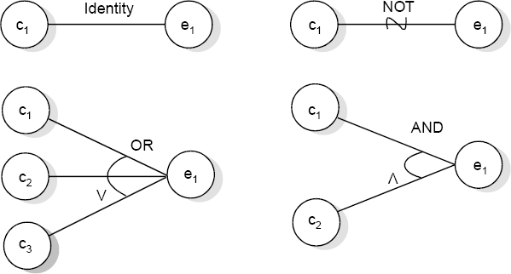
Software Testing
The basic notation for the graph is shown in fig. 8
Fig.8 : Basic cause effect graph symbols
93

Slide 94
Software Testing
Myers explained this effectively with following example. “The characters in column 1 must be an A or B. The character in column 2 must be a digit. In this situation, the file update is made. If the character in column 1 is incorrect, message x is issued. If the character in column 2 is not a digit, message y is issued”.
The causes are
c₁: character in column 1 is A c₂: character in column 1 is B
c₃: character in column 2 is a digit
and the effects are
e₁: update made
e₂: message x is issued e₃: message y is issued
94

Slide 95
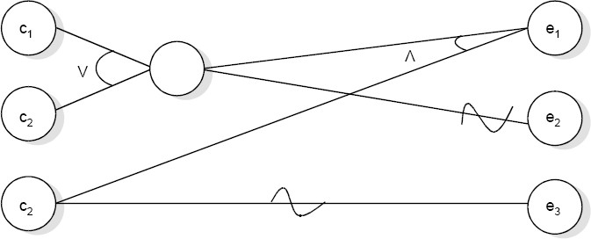
Software Testing
Fig. 9: Sample cause effect graph
95

Slide 96
Software Testing
The E constraint states that it must always be true that at most one of c₁ or c₂ can be 1 (c₁ or c₂ cannot be 1 simultaneously). The I constraint states that at least one of c₁, c₂ and c₃ must always be 1 (c₁, c₂ and c₃ cannot be 0 simultaneously). The O constraint states that one, and only one, of c₁ and c₂ must be 1. The constraint R states that, for c₁ to be 1, c₂ must be 1 (i.e. it is impossible for c₁ to be 1 and c₂ to be 0),
96

Slide 97
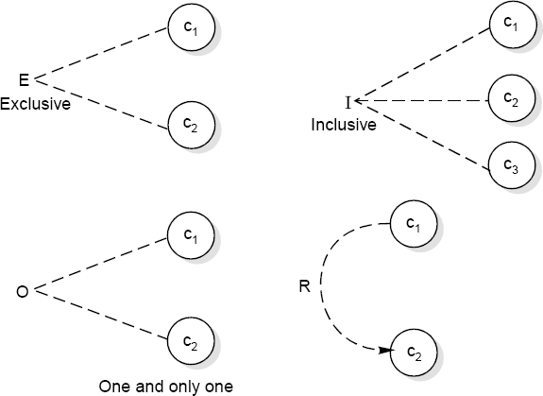
Software Testing
Fig. 10: Constraint symbols
97

Slide 98
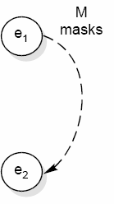
Software Testing
Fig. 11: Symbol for masks constraint
98

Slide 99
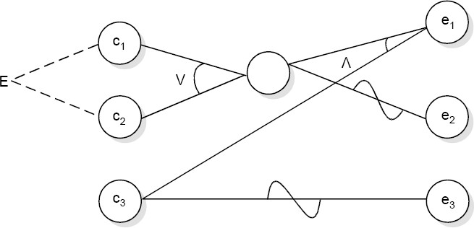
Software Testing
Fig. 12 : Sample cause effect graph with exclusive constraint
99

Slide 100
Software Testing
Example 12
Consider the triangle problem specified in the example 3. Draw the Cause effect graph and identify the test cases.
100

Slide 101
Software Testing
Solution
The causes are
c₁: side x is less than sum of sides y and z c₂: side y is less than sum of sides x and y c₃: side z is less than sum of sides x and y c₄: side x is equal to side y
c₅: side x is equal to side z c₆: side y is equal to side z
and effects are
e₁: Not a triangle
e₂: Scalene triangle e₃: Isosceles triangle e₄: Equilateral triangle e₅: Impossible stage
101

Slide 102
Software Testing
The cause effect graph is shown in fig. 13 and decision table is shown in table 6. The test cases for this problem are available in Table 5.
Conditions C₁: x < y + z ? | 0 | 1 | 1 | 1 | 1 | 1 | 1 | 1 | 1 | 1 | 1
C₂: y < x + z ? | X | 0 | 1 | 1 | 1 | 1 | 1 | 1 | 1 | 1 | 1
C₃: z < x + y ? | X | X | 0 | 1 | 1 | 1 | 1 | 1 | 1 | 1 | 1
C₄: x = y ? | X | X | X | 1 | 1 | 1 | 1 | 0 | 0 | 0 | 0
C₅: x = z ? | X | X | X | 1 | 1 | 0 | 0 | 1 | 1 | 0 | 0
C₆: y = z ? | X | X | X | 1 | 0 | 1 | 0 | 1 | 0 | 1 | 0
e₁: Not a triangle | 1 | 1 | 1
e₂: Scalene |  |  |  |  |  |  |  |  |  |  | 1
e₃: Isosceles |  |  |  |  |  |  | 1 |  | 1 | 1
e₄: Equilateral |  |  |  | 1
e₅: Impossible |  |  |  |  | 1 | 1 |  | 1
Table 6: Decision table
102
Software Engineering (3 ed.), By K.K Aggarwal & Yogesh Singh, Copyright © New Age International Publishers, 2007
rd

Slide 103
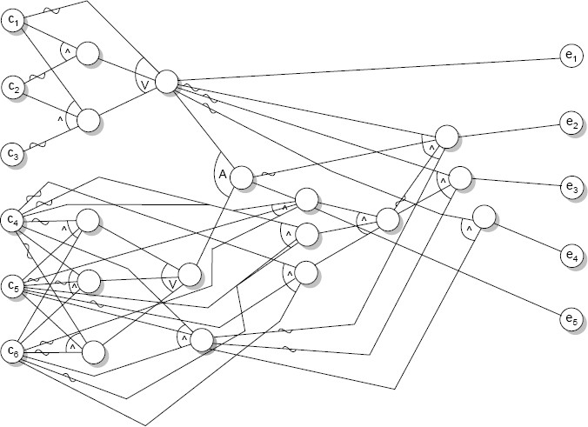
Software Testing
Fig. 13: Cause effect graph of triangle problem
103

Slide 104
Software Testing
Structural Testing
A complementary approach to functional testing is called structural / white box testing. It permits us to examine the internal structure of the program.
Path Testing
Path testing is the name given to a group of test techniques based on judiciously selecting a set of test paths through the program. If the set of paths is properly chosen, then it means that we have achieved some measure of test thoroughness.
This type of testing involves:
generating a set of paths that will cover every branch in the program.
finding a set of test cases that will execute every path in the set of program paths.
104

Slide 105
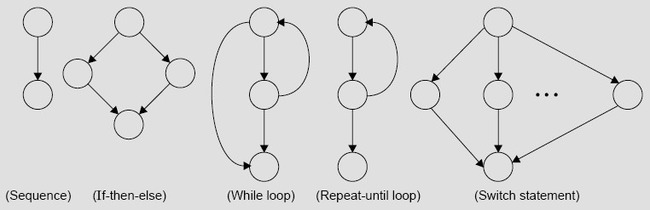
Software Testing
Flow Graph
The control flow of a program can be analysed using a graphical representation known as flow graph. The flow graph is a directed graph in which nodes are either entire statements or fragments of a statement, and edges represents flow of control.
Fig. 14: The basic construct of the flow graph
105

Slide 106
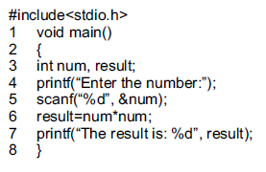


Slide 107
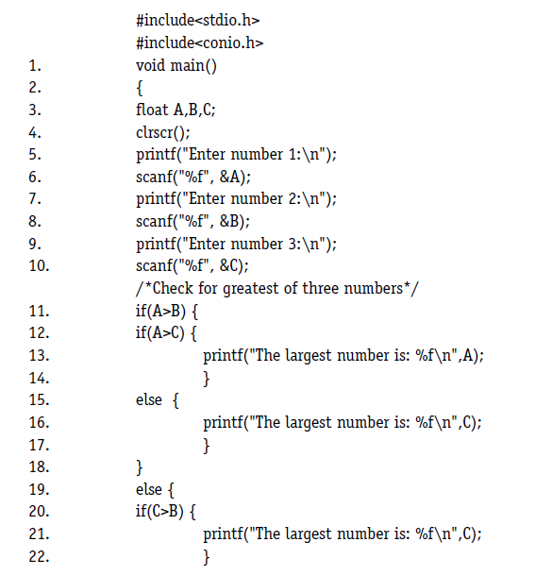
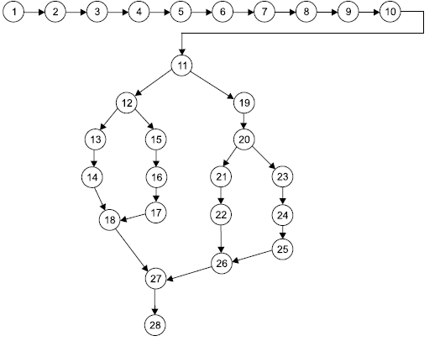
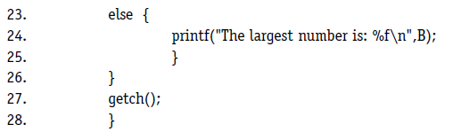

Slide 108
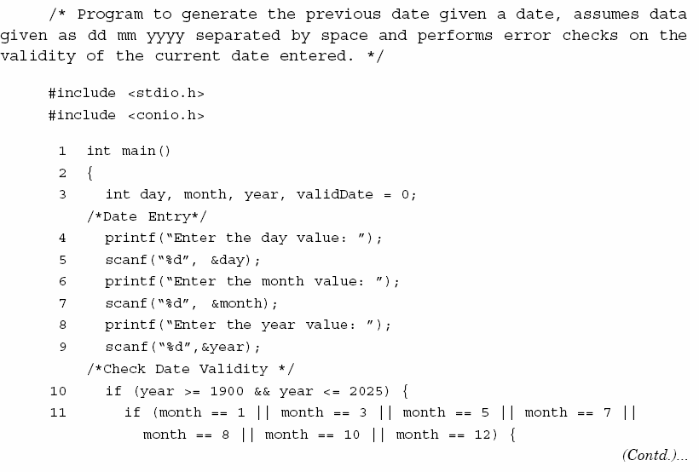
Software Testing
106

Slide 109
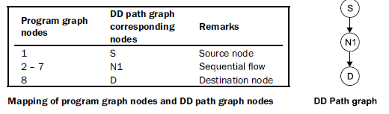
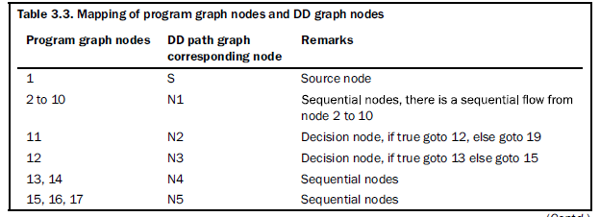
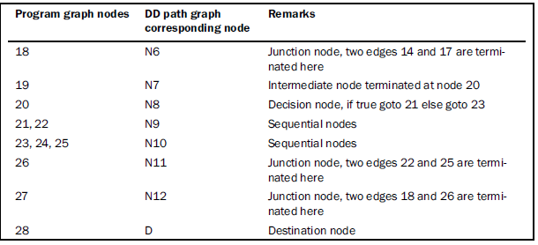

Slide 110
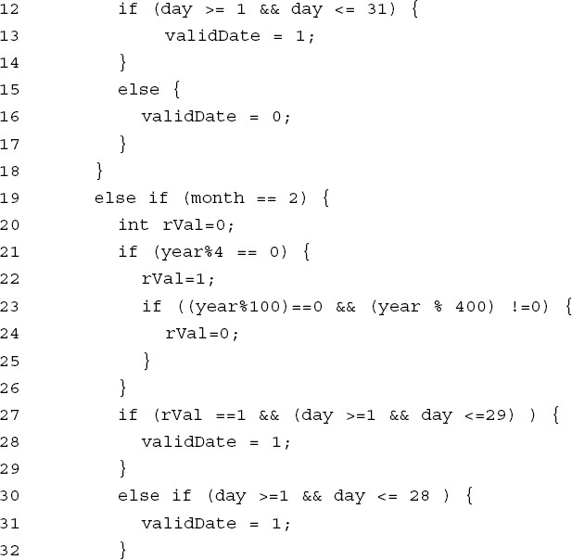
Software Testing
107

Slide 111
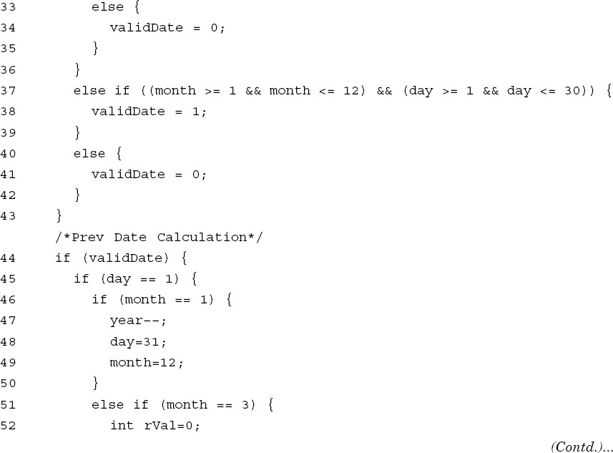
Software Testing
108

Slide 112
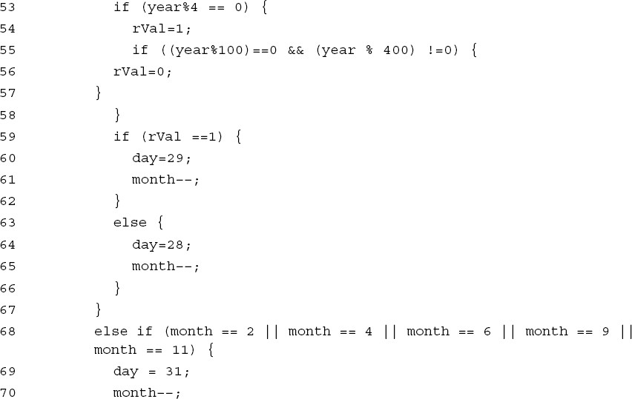
Software Testing
109

Slide 113
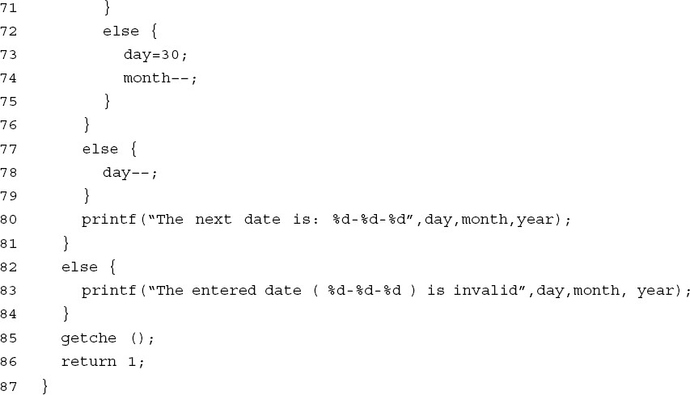
Software Testing
Fig. 15: Program for previous date problem
110

Slide 114
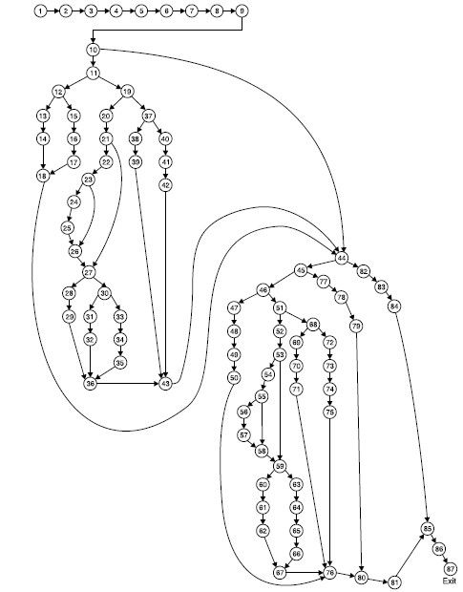
Software Testing
Fig. 16: Flow graph of previous date problem
111

Slide 115
Software Testing
Decision to Decision (DD) Path Graph
Table 7: Mapping of flow graph nodes and DD path nodes
Flow graph nodes | DD Path graph corresponding node | Remarks
1 to 9 | n₁ | There is a sequential flow from node 1 to 9
10 | n₂ | Decision node, if true go to 13 else go to 44
11 | n₃ | Decision node, if true go to 12 else go to 19
12 | n₄ | Decision node, if true go to 13 else go to 15
13,14 | n₅ | Sequential nodes and are combined to form new node n₅
15,16,17 | n₆ | Sequential nodes
18 | n₇ | Edges from node 14 to 17 are terminated here
19 | n₈ | Decision node, if true go to 20 else go to 37
20 | n₉ | Intermediate node with one input edge and one output edge
21 | ^{n}10 | Decision node, if true go to 22 else go to 27
22 | ^{n}11 | Intermediate node
23 | ^{n}12 | Decision node, if true go to 24 else go to 26
Cont…¹¹.²

Slide 116
Software Testing
Flow graph nodes | DD Path graph corresponding node | Remarks
24,25 | ^{n}13 | Sequential nodes
26 | ^{n}14 | Two edges from node 25 & 23 are terminated here
27 | ^{n}15 | Two edges from node 26 & 21 are terminated here. Also a decision node
28,29 | ^{n}16 | Sequential nodes
30 | ^{n}17 | Decision node, if true go to 31 else go to 33
31,32 | ^{n}18 | Sequential nodes
33,34,35 | ^{n}19 | Sequential nodes
36 | ^{n}20 | Three edge from node 29,32 and 35 are terminated here
37 | ^{n}21 | Decision node, if true go to 38 else go to 40
38,39 | ^{n}22 | Sequential nodes
40,41,42 | ^{n}23 | Sequential nodes
43 | ^{n}24 | Three edge from node 36,39 and 42 are terminated here
Cont….
113

Slide 117
Software Testing
Flow graph nodes | DD Path graph corresponding node | Remarks
44 | ^{n}25 | Decision node, if true go to 45 else go to 82. Three edges from 18,43 & 10 are also terminated here.
45 | ^{n}26 | Decision node, if true go to 46 else go to 77
46 | ^{n}27 | Decision node, if true go to 47 else go to 51
47,48,49,50 | ^{n}28 | Sequential nodes
51 | ^{n}29 | Decision node, if true go to 52 else go to 68
52 | ^{n}30 | Intermediate node with one input edge & one output ege
53 | ^{n}31 | Decision node, if true go to 54 else go to 59
54 | ^{n}32 | Intermediate node
55 | ^{n}33 | Decision node, if true go to 56 else go to 58
56,57 | ^{n}34 | Sequential nodes
58 | ^{n}35 | Two edge from node 57 and 55 are terminated here
59 | ^{n}36 | Decision node, if true go to 60 else go to 63. Two edge from nodes 58 and 53 are terminated.
Cont….
114

Slide 118
Software Testing
Flow graph nodes | DD Path graph corresponding node | Remarks
60,61,62 | ^{n}37 | Sequential nodes
63,64,65,66 | ^{n}38 | Sequential nodes
67 | ^{n}39 | Two edge from node 62 and 66 are terminated here
68 | ^{n}40 | Decision node, if true go to 69 else go to 72
69,70,71 | ^{n}41 | Sequential nodes
72,73,74,75 | ^{n}42 | Sequential nodes
76 | ^{n}43 | Four edges from nodes 50, 67, 71 and 75 are terminated here.
77,78,79 | ^{n}44 | Sequential nodes
80 | ^{n}45 | Two edges from nodes 76 & 79 are terminated here
81 | ^{n}46 | Intermediate node
82,83,84 | ^{n}47 | Sequential nodes
85 | ^{n}48 | Two edges from nodes 81 and 84 are terminated here
86,87 | ^{n}49 | Sequential nodes with exit node
115

Slide 119
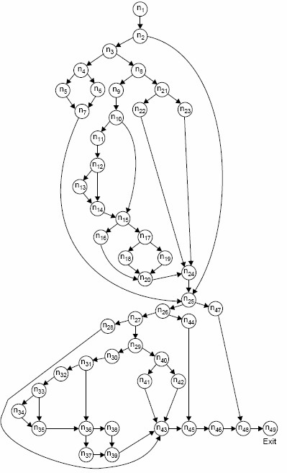
Software Testing
Fig. 17: DD path graph of previous date problem
116

Slide 120
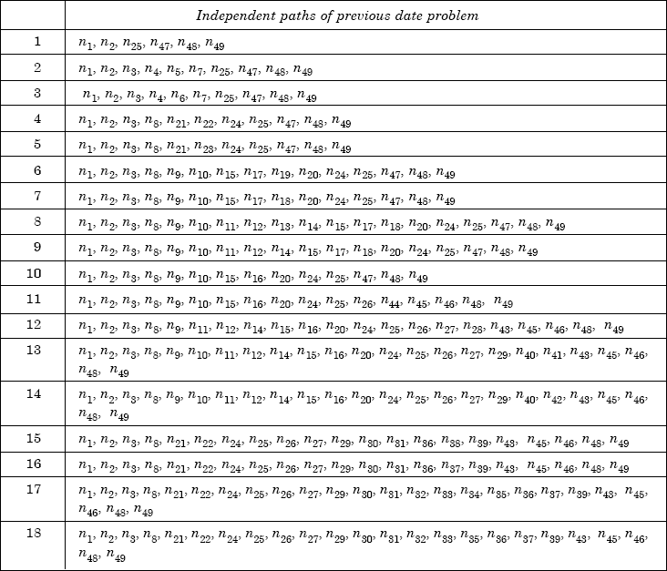
Software Testing
Fig. 18: Independent paths of previous date problem
117

Slide 121
Software Testing
Example 8.13
Consider the problem for the determination of the nature of roots of a quadratic equation. Its input a triple of positive integers (say a,b,c) and value may be from interval [0,100].
The program is given in fig. 19. The output may have one of the following words: [Not a quadratic equation; real roots; Imaginary roots; Equal roots]
Draw the flow graph and DD path graph. Also find independent paths from the DD Path graph.
118

Slide 122
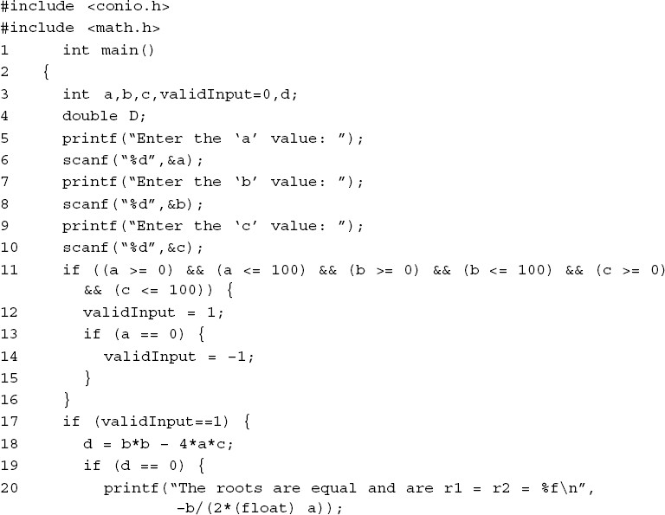
Software Testing
Cont….
119

Slide 123
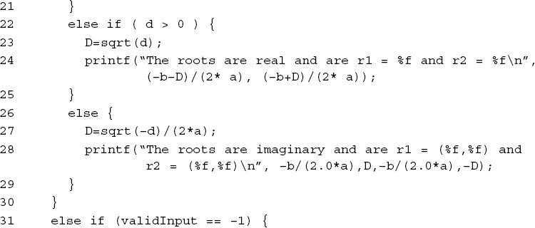
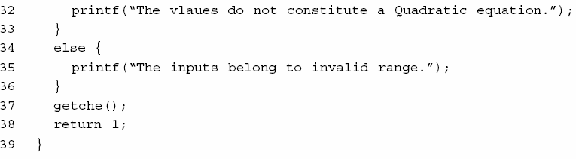
Software Testing
Fig. 19: Code of quadratic equation problem
120

Slide 124
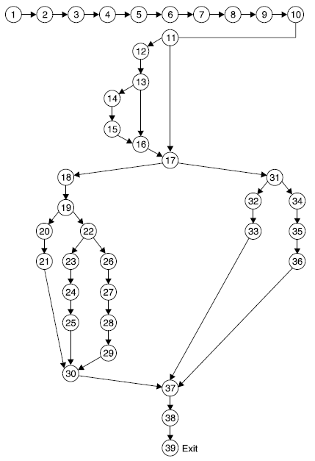
Software Testing
Solution
Fig. 19 (a) : Program flow graph
121

Slide 125
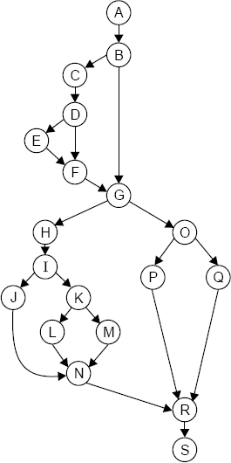
Software Testing
Fig. 19 (b) : DD Path graph
122

Slide 126
Software Testing
The mapping table for DD path graph is:
Flow graph nodes | DD Path graph corresponding node | Remarks
1 to 10 | A | Sequential nodes
11 | B | Decision node
12 | C | Intermediate node
13 | D | Decision node
14,15 | E | Sequential node
16 | F | Two edges are combined here
17 | G | Two edges are combined and decision node
18 | H | Intermediate node
19 | I | Decision node
20,21 | J | Sequential node
22 | K | Decision node
23,24,25 | L | Sequential node
Cont….
123
Software Engineering (3rd ed.), By K.K Aggarwal & Yogesh Singh, Copyright © New Age International Publishers, 2007

Slide 127
Software Testing
Flow graph nodes | DD Path graph corresponding node | Remarks
26,27,28,29 | M | Sequential nodes
30 | N | Three edges are combined
31 | O | Decision node
32,33 | P | Sequential node
34,35,36 | Q | Sequential node
37 | R | Three edges are combined here
38,39 | S | Sequential nodes with exit node
Independent paths are:
(i) ABGOQRS
(iii) ABCDFGOQRS
ABGHIJNRS
ABGHIKMNRS
(ii) ABGOPRS
(iv) ABCDEFGOPRS
(vi) ABGHIKLNRS
124

Slide 128
Software Testing
Example 8.14
Consider a program given in Fig.8.20 for the classification of a triangle. Its input is a triple of positive integers (say a,b,c) from the interval [1,100]. The output may be [Scalene, Isosceles, Equilateral, Not a triangle].
Draw the flow graph & DD Path graph. Also find the independent paths from the DD Path graph.
125

Slide 129
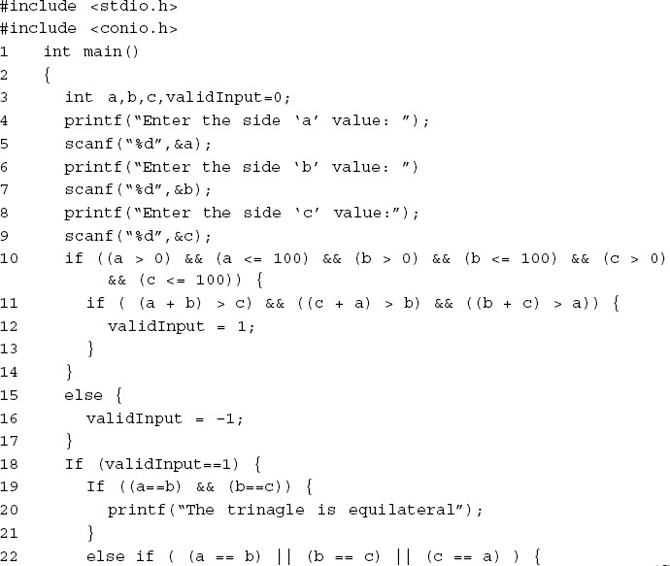

Software Testing
126

Slide 130
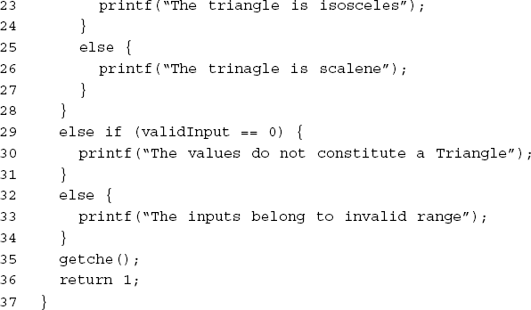
Software Testing
Fig. 20 : Code of triangle classification problem
127

Slide 131
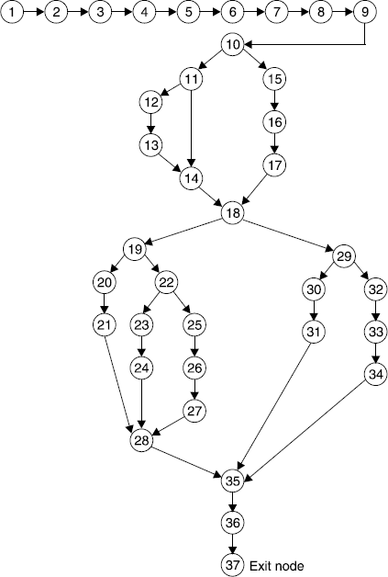
Software Testing
Solution :
Flow graph of triangle problem is:
Fig.8. 20 (a): Program flow graph
128

Slide 132
Software Testing
The mapping table for DD path graph is:
Flow graph nodes | DD Path graph corresponding node | Remarks
1 TO 9 | A | Sequential nodes
10 | B | Decision node
11 | C | Decision node
12, 13 | D | Sequential nodes
14 | E | Two edges are joined here
15, 16, 17 | F | Sequential nodes
18 | G | Decision nodes plus joining of two edges
19 | H | Decision node
20, 21 | I | Sequential nodes
22 | J | Decision node
23, 24 | K | Sequential nodes
25, 26, 27 | L | Sequential nodes
Cont….
Software Engineering (3rd ed.), By K.K Aggarwal & Yogesh Singh, Copyright © New Age International Publishers, 2007
129

Slide 133
Software Testing
Flow graph nodes | DD Path graph corresponding node | Remarks
28 | M | Three edges are combined here
29 | N | Decision node
30, 31 | O | Sequential nodes
32, 33, 34 | P | Sequential nodes
35 | Q | Three edges are combined here
36, 37 | R | Sequential nodes with exit node
Fig. 20 (b): DD Path graph
130

Slide 134
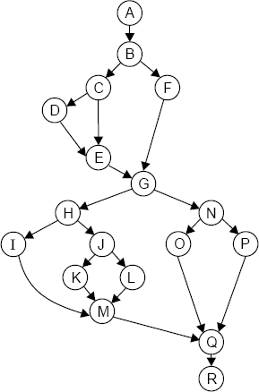
Software Testing
DD Path graph is given in Fig. 20 (b)
Independent paths are:
ABFGNPQR
ABFGNOQR
ABCEGNPQR
ABCDEGNOQR
ABFGHIMQR
ABFGHJKMQR (vii)ABFGHJMQR
Fig. 20 (b): DD Path graph
131

Slide 135
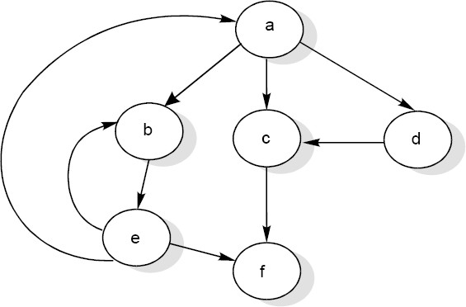
Software Testing
Cyclomatic Complexity
McCabe’s cyclomatic metric V(G) = e – n + 2P.
For example, a flow graph shown in in Fig. 21 with entry node ‘a’ and exit node ‘f’.
Fig. 21: Flow graph
132

Slide 136
Software Testing
The value of cyclomatic complexity can be calculated as : V(G) = 9 – 6 + 2 = 5
Here e = 9, n = 6 and P =1
There will be five independent paths for the flow graph illustrated in Fig. 21.
Path 1 :
Path 2 :
Path 3 :
Path 4 :
Path 5 :
a c f
a b e f a d c f
a b e a c f or a b e a b e f a b e b e f
133

Slide 137
Software Testing
Several properties of cyclomatic complexity are stated below:
1. V(G) ≥1
V (G) is the maximum number of independent paths in graph G.
Inserting & deleting functional statements to G does not affect V(G).
G has only one path if and only if V(G)=1.
Inserting a new row in G increases V(G) by unity.
V(G) depends only on the decision structure of G.
134

Slide 138
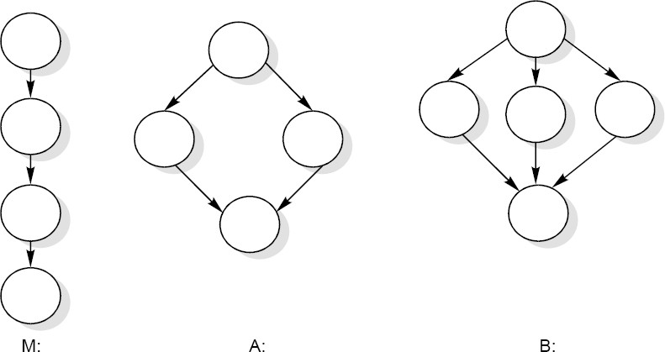
Software Testing
The role of P in the complexity calculation V(G)=e-n+2P is required to be understood correctly. We define a flow graph with unique entry and exit nodes, all nodes reachable from the entry, and exit reachable from all nodes. This definition would result in all flow graphs having only one connected component. One could, however, imagine a main program M and two called subroutines A and B having a flow graph shown in Fig. 22.
Fig. 22
135

Slide 139
Software Testing
Let us denote the total graph above with 3 connected components as
V (M ∪ A ∪ B) = e − n + 2P
= 13-13+2*3
= 6
This method with P ≠
1 can be used to calculate the complexity of a
collection of programs, particularly a hierarchical nest of subroutines.
136

Slide 140
Software Testing
Notice that
V (M ∪ A ∪ B) = V (M ) + V ( A) + V (B) = 6
. In general, the
complexity of a collection C of flow graphs with K connected components is equal to the summation of their complexities. To see this let C_{i},1 ≤ I ≤ K denote the k distinct connected component, and let e_{i} and n_{i} be the number of edges and nodes in the ith-connected component. Then
k k
V (C) = e − n + 2 p = ∑e_{i} − ∑ n_{i} + 2K
i=1 i=1
= ∑(e_{i} − n_{i} + 2) = ∑V (C_{i} )
i=1 i=1
k
k
137

Slide 141
Software Testing
Two alternate methods are available for the complexity calculations.
Cyclomatic complexity V(G) of a flow graph G is equal to the number of predicate (decision) nodes plus one.
V(G)= ∏ +1
Where ∏ is the number of predicate nodes contained in the flow graph G.
Cyclomatic complexity is equal to the number of regions of the flow graph.
138

Slide 142
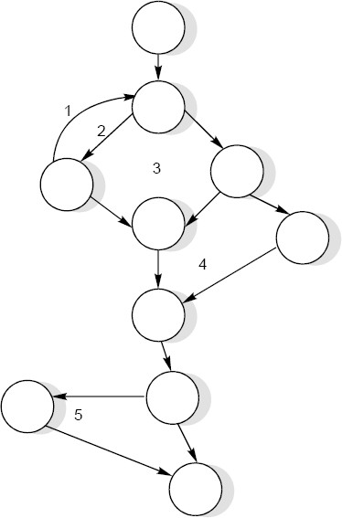
Software Testing
Example 8.15
Consider a flow graph given complexity by all three methods.
in Fig. 23 and calculate the cyclomatic
Fig. 23
139

Slide 143
Software Testing
Solution
Cyclomatic complexity can be calculated by any of the three methods.
1. V(G)
= e – n + 2P
= 13 – 10 + 2 = 5
2. V(G)
= π + 1
= 4 + 1 = 5
3. V(G)
= number of regions
= 5
Therefore, complexity value of a flow graph in Fig. 23 is 5.
140

Slide 144
Software Testing
Example 8.16
Consider the previous date program with DD path graph given in Fig. 17. Find cyclomatic complexity.
141

Slide 145
Software Testing
Solution
Number of edges (e) = 65 Number of nodes (n) =49
(i)
(ii)
(iii)
V(G) = e – n + 2P = 65 – 49 + 2 = 18 V(G) = π + 1 = 17 + 1 = 18
V(G) = Number of regions = 18
The cyclomatic complexity is 18.
142

Slide 146
Software Testing
Example 8.17
Consider the quadratic equation problem given in example 8.13 with its DD Path graph. Find the cyclomatic complexity:
143

Slide 147
Software Testing
Solution
Number of nodes (n) = 19 Number of edges (e) = 24
(i) V(G) = e – n + 2P = 24 – 19 + 2 = 7 (ii) V(G) = π + 1 = 6 + 1 = 7
(iii) V(G) = Number of regions = 7
Hence cyclomatic complexity is 7 independent paths in the DD Path graph.
meaning
thereby,
seven
144

Slide 148
Software Testing
Example 8.18
Consider the classification of triangle problem given in example 8.14. Find the cyclomatic complexity.
145

Slide 149
Software Testing
Solution
Number of edges (e) = 23 Number of nodes (n) =18
(i) V(G) = e – n + 2P = 23 – 18 + 2 = 7 (ii) V(G) = π + 1 = 6 + 1 = 7
(iii) V(G) = Number of regions = 7
The cyclomatic complexity is 7. Hence, there are seven independent paths as given in example 8.14.
146

Slide 150
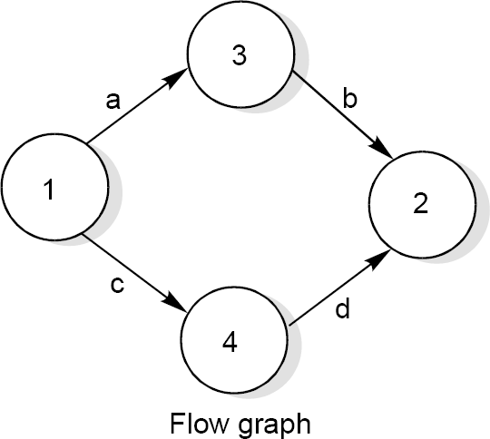
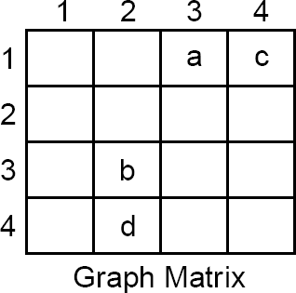
Software Testing
Graph Matrices
A graph matrix is a square matrix with one row and one column for every node in the graph. The size of the matrix (i.e., the number of rows and columns) is equal to the number of nodes in the flow graph. Some examples of graphs and associated matrices are shown in fig. 24.
Fig. 24 (a): Flow graph and graph matrices
147

Slide 151
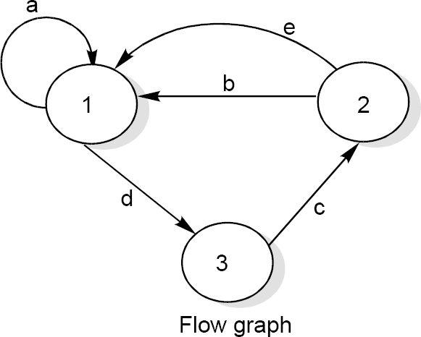
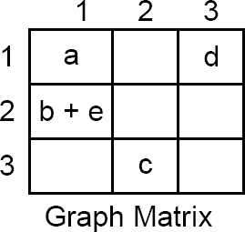
Software Testing
Fig. 24 (b): Flow graph and graph matrices
148

Slide 152
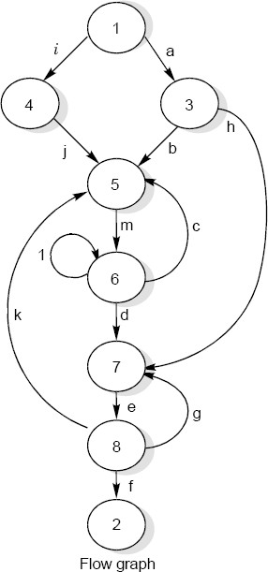
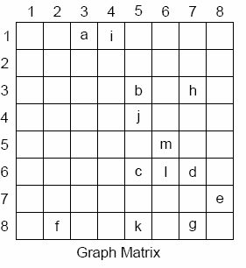
Software Testing
Fig. 24 (c): Flow graph and graph matrices
149

Slide 153
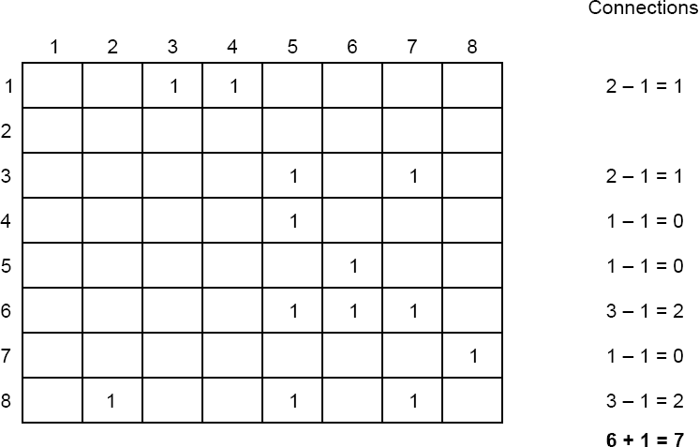
Software Testing
Fig. 25 : Connection matrix of flow graph shown in Fig. 24 (c)
150

Slide 154
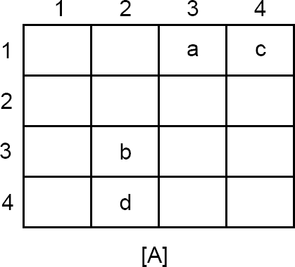
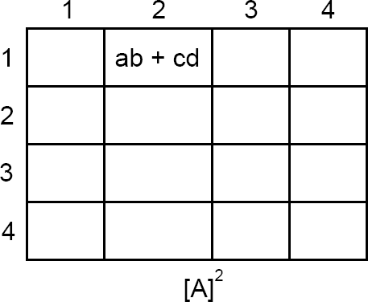
Software Testing
The square matrix represent that there are two path ab and cd from node 1 to node 2.
151

Slide 155
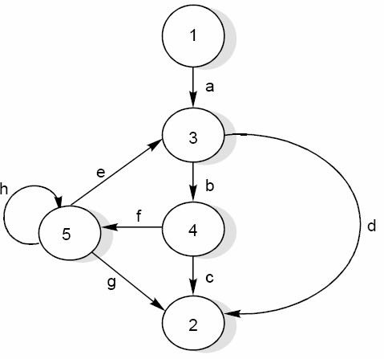
Software Testing
Example 8.19
Consider the flow graph shown in the Fig. 26 and draw the graph & connection matrices. Find out cyclomatic complexity and two / three link paths from a node to any other node.
Fig. 26 : Flow graph
152

Slide 156
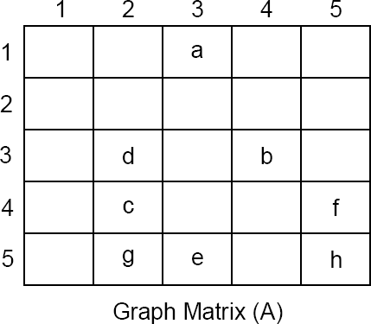
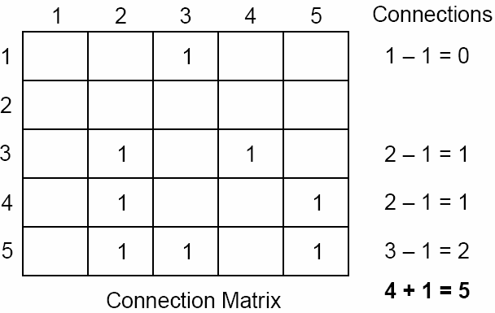
Software Testing
Solution
The graph & connection matrices are given below :
To find two link paths, we have to generate a square of graph matrix [A] and for three link paths, a cube of matrix [A] is required.
153

Slide 157
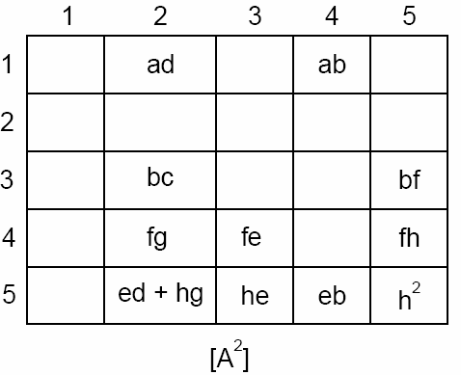

Software Testing
154

Slide 158
Software Testing
Control Flow Testing
We identify paths of the program and write test cases to execute those paths.
We define ‘coverage’ as a ‘percentage of source code that has been tested with respect to the total source code available for testing’.
The most reasonable level may be to test every statement of a program at least once before the completion of testing.
We may write test cases that ensure the execution of every statement.
155

Slide 159

Software Testing
155

Slide 160

Software Testing
155

Slide 161
Software Testing
Branch Coverage :
We want to test every branch of the program. Hence, we wish to test every ‘True’ and ‘False’ condition of the program.
a = 9, b = 8, c = 7
a = 7, b = 8, c = 9
Condition Coverage:
Condition coverage is better than branch coverage because we want to test every condition at least once.
(i) a = 9, b = 8, c = 7 (first possibility when both are true)
(ii) a = 9, b = 8, c = 10 (second possibility – first is true, second is false)
(iii) a = 7, b = 8, c = 9 (third and fourth possibilities- first is false, statement number 7 is false)
155

Slide 162

Software Testing
Path Coverage:
In this coverage criteria, we want to test every path of the program.
155

Slide 163
Software Testing
Data Flow Testing
Data flow testing is another from of structural testing. It has nothing to do with data flow diagrams.
Statements where variables receive values.
Statements where these values are used or referenced.
As we know, variables are defined and referenced throughout the program. We may have few define/ reference anomalies:
A variable is defined but not used/ referenced.
A variable is used but never defined.
A variable is defined twice before it is used.
155

Slide 164
Software Testing
Definitions
The definitions refer to a program P that has a program graph G(P) and a set of program variables V. The G(P) has a single entry node and a single exit node. The set of all paths in P is PATHS(P)
Defining Node: Node n z G(P) is a defining node of the variable v z V, written as DEF (v, n), if the value of the variable v is defined at the statement fragment corresponding to node n.
Usage Node: Node n z G(P) is a usage node of the variable v z V, written as USE (v, n), if the value of the variable v is used at statement fragment corresponding to node n. A usage node USE (v, n) is a predicate use (denote as p) if statement n is a predicate statement otherwise USE (v, n) is a computation use (denoted as c).
156

Slide 165
Software Testing
Definition use: A definition use path with respect to a variable v (denoted du-path) is a path in PATHS(P) such that, for some v z V, there are define and usage nodes DEF(v, m) and USE(v, n) such that m and n are initial and final nodes of the path.
Definition clear : A definition clear path with respect to a variable v (denoted dc-path) is a definition use path in PATHS(P) with initial and final nodes DEF (v, m) and USE (v, n), such that no other node in the path is a defining node of v.
The du-paths and dc-paths describe the flow of data across source statements from points at which the values are defined to points at which the values are used. The du-paths that are not definition clear are potential trouble spots.
157

Slide 166

Software Testing

Slide 167

Software Testing
Hence, our objective is to find all du-paths and then identity those du-paths which are not dc-paths. The steps are given in Fig. 27. We may like to generate specific test cases for du-paths that are not dc-paths.
Fig. 27 : Steps for data flow testing
158

Slide 168



Slide 169


Slide 170


Slide 171


Slide 172





Slide 173
Software Testing
Example 8.20
Consider the program of the determination of the nature of roots of a quadratic equation. Its input is a triple of positive integers (say a,b,c) and values for each of these may be from interval [0,100]. The program is given in Fig. 19. The output may have one of the option given below:
Not a quadratic program
real roots
imaginary roots
equal roots
invalid inputs
Find all du-paths and identify those du-paths that are definition clear.
159

Slide 174
Software Testing
Solution
Step I: The program flow graph is given in Fig. 19 (a). The variables used in the program are a,b,c,d, validinput, D.
Step II: DD Path graph is given in Fig. 19(b). The cyclomatic complexity of this graph is 7 indicating there are seven independent paths.
Step III: Define/use nodes for all variables are given below:
Variable | Defined at node | Used at node
a | 6 | 11,13,18,20,24,27,28
b | 8 | 11,18,20,24,28
c | 10 | 11,18
d | 18 | 19,22,23,27
D | 23, 27 | 24,28
Validinput | 3, 12, 14 | 17,31
160

Slide 175
Software Testing
Variable | Path (beginning, end) nodes | Definition clear ?
c | 10, 11 10, 18 | Yes Yes
d | 18, 19 | Yes
 | 18, 22 | Yes
 | 18, 23 | Yes
 | 18, 27 | Yes
D | 23, 24 | Yes
 | 23, 28 | Path not possible
 | 27, 24 | Path not possible
 | 27, 28 | Yes
validinput | 3, 17 3, 31 | no no
 | 12, 17 | no
 | 12, 31 | no
 | 14, 17 | yes
 | 14, 31 | yes
162

Slide 176
Software Testing
Example 8.21
Consider the program given in Fig. 20 for the classification of a triangle. Its input is a triple of positive integers (say a,b,c) from the interval [1,100]. The output may be:
[Scalene, Isosceles, Equilateral, Not a triangle, Invalid inputs].
Find all du-paths and identify those du-paths that are definition clear.
163

Slide 177
Software Testing
Solution
Step I: The program flow graph is given in Fig. 20 (a). The variables used in the program are a,b,c, valid input.
Step II: DD Path graph is given in Fig. 20(b). The cyclomatic complexity of this graph is 7 and thus, there are 7 independent paths.
Step III: Define/use nodes for all variables are given below:
Variable | Defined at node | Used at node
a | 6 | 10, 11, 19, 22
b | 7 | 10, 11, 19, 22
c | 9 | 10, 11, 19, 22
valid input | 3, 13, 16 | 18, 29
164

Slide 178
Software Testing
Variable | Path (beginning, end) nodes | Definition clear ?
c | 9, 10 9, 11 | Yes Yes
 | 9, 19 | Yes
 | 9, 22 | Yes
valid input | 3, 18 3, 29 | no no
 | 12, 18 | no
 | 12, 29 | no
 | 16, 18 | Yes
 | 16, 29 | Yes
Hence total du-paths are 18 out of which four paths are not definition clear
166

